Slide 1
Exploring the Effectiveness of Sigma Rules and Machine Learning for Anomaly Detection in Audit Logs
利用 Sigma 規則與機器學習方法之系統日誌異常偵測

Slide 2
Outlines
Motivation
Objectives
Methodology
System Architecture
Modules Elaberation
Analysis / Evaluation
Findings
Conclusions

Slide 3
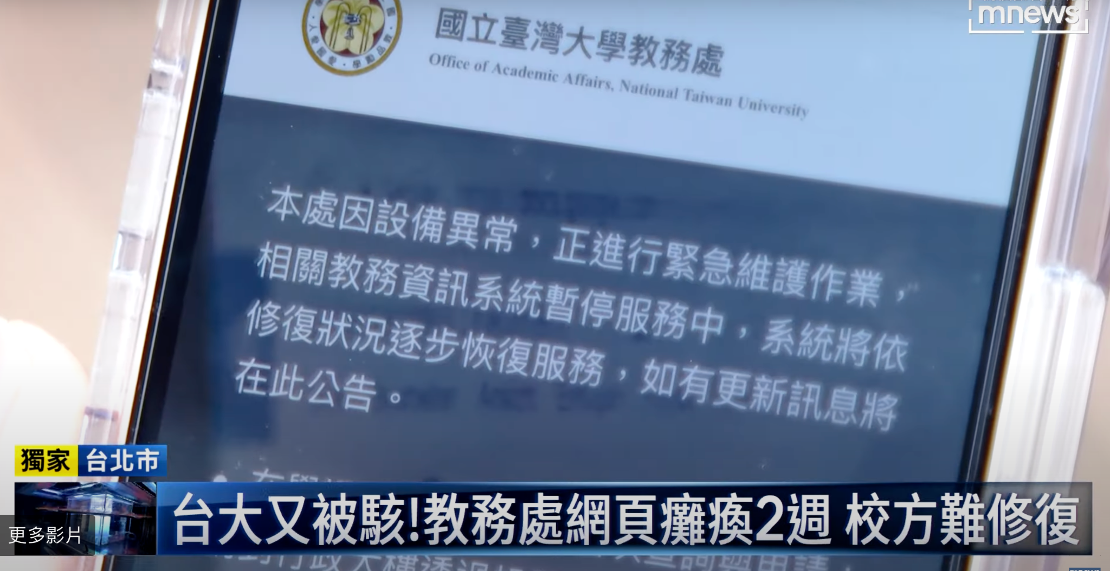
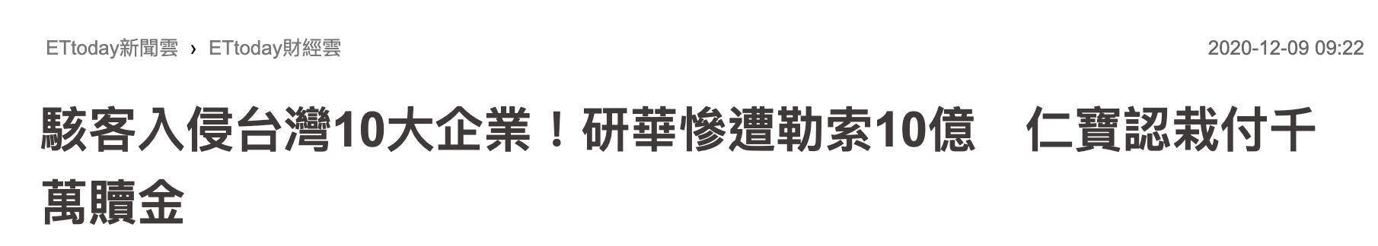
Motivation: Cyber Threats Are Everywhere
Q: How to combat cyber threat through attacker’s footprints left in the system?
政府、學校、公司例子各一

Slide 4
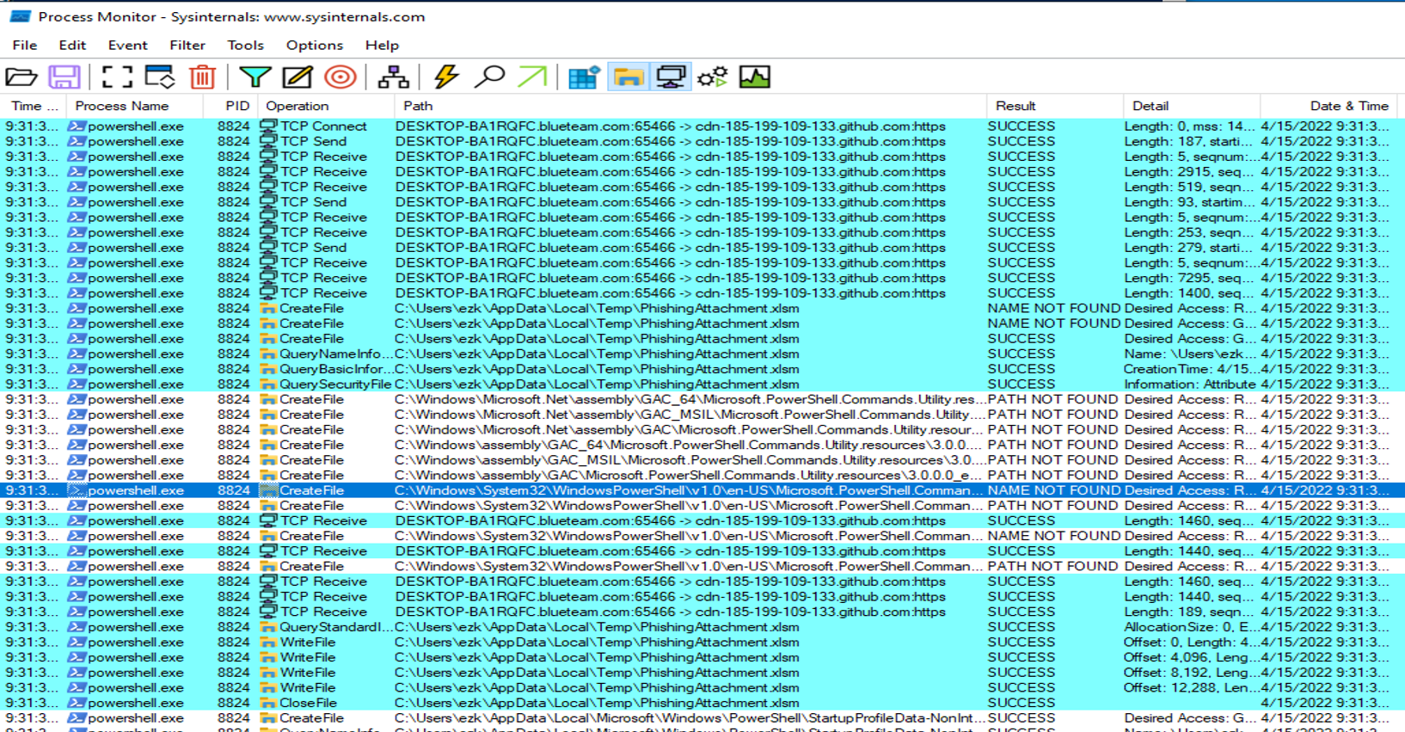
Attack Footprints: Audit logs
Audit log is an audit trail that is essentially a record of events and changes in a host system.
Through events in audit logs, one can correlate and analyze events to infer malicious or suspicious activity intents)
1. Connect to github
2. Download Phishing Attachment
Fig1. Two actions can be observed in this log example, which are Connect To Github and Download Phishing Attachment. It shows an spearphishing malicious activity may be activated in the system.
Notes:
Phishing: Spearphishing Attachment

Slide 5
Background: Data Provenance
Provenance graphs encode causal dependence relations between system subjects (e.g., processes) and system objects (e.g., file, network, registry)
navigating through a provenance graph is much more easier to observe the overall entity interaction than directly analyzing tedious logs events.
system object: network
1. Connect to github
system object: file
2. Download Phishing Attachment
system subject: process
relation
DESKTOP-BA1RQFC.blueteam.com: 65466 ->
cdn-185-199-109-133.github:https
1. Connect to github
TCP Connect
TCP Send
TCP Receive
TCP Disconnect
powershell.exe
CreateFile
QueryBasicInformationFile
WriteFile
C:\Users\ezk\AppData\Local\Temp\PhishingAttachment.xlsm
CloseFile
2. Download Phishing Attachment
Notes:
Navigating through a provenance graph is much more easier to observe the overall attack scenario.

Slide 6
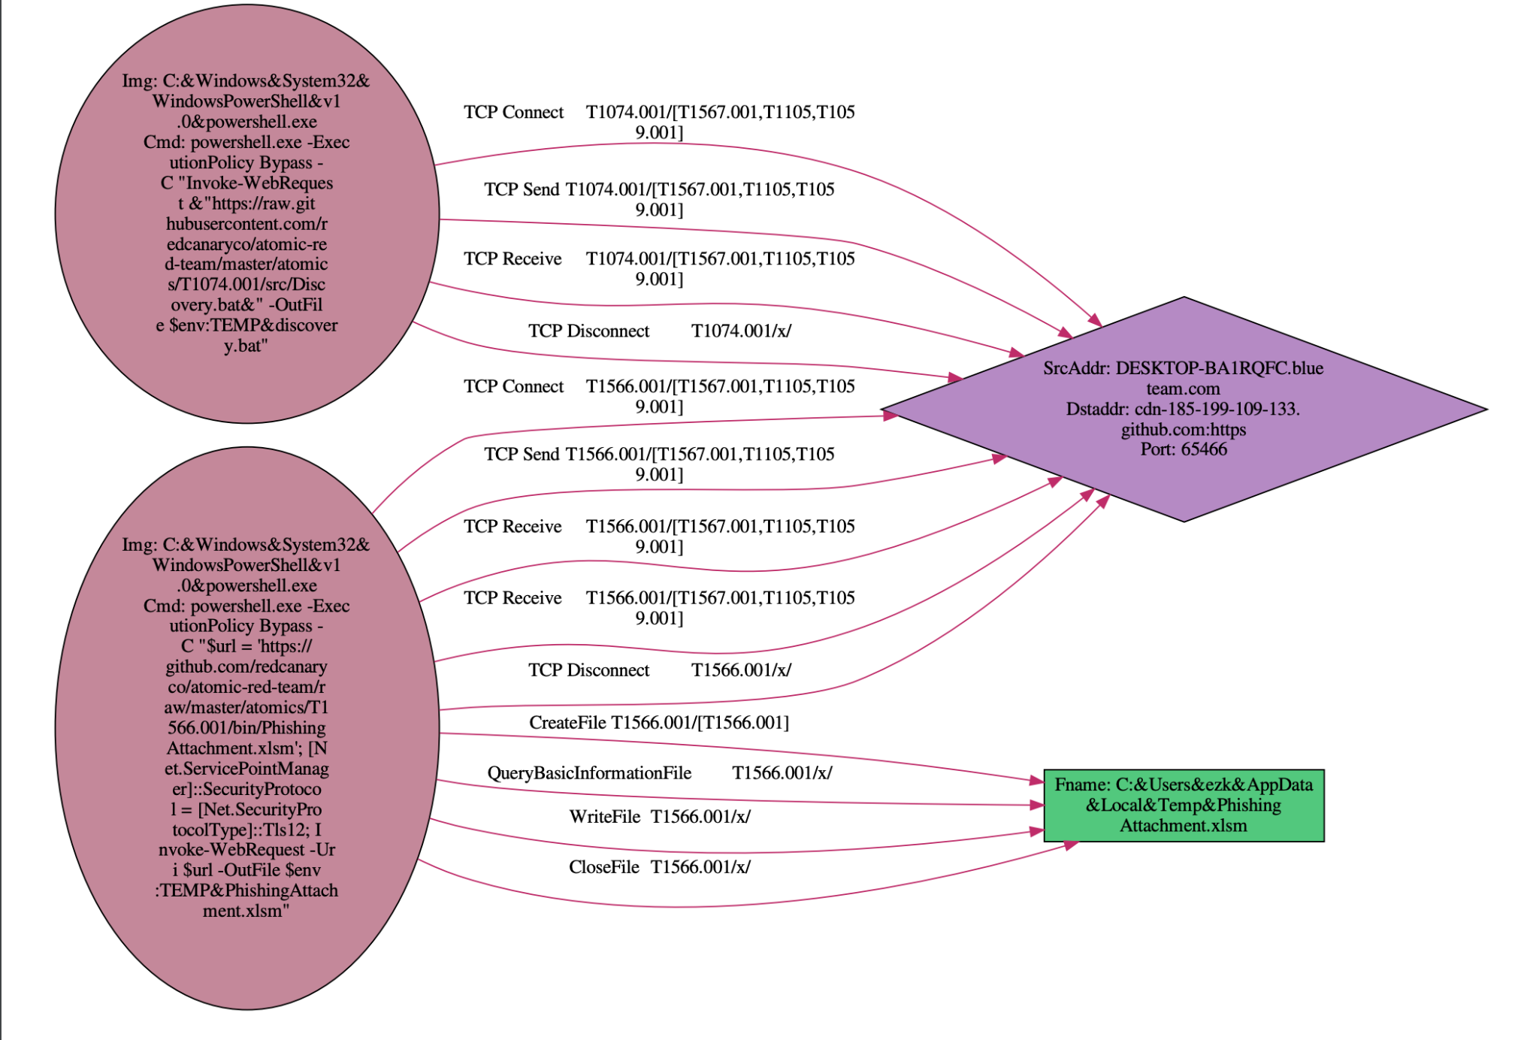
SrcAddress: DESKTOP-BA1RQFC.blueteam.com
DstAddress:
cdn-185-199-109-133.github:https
Port: 65466
TCP Connect
TCP Send
Img: powershell.exe
Cmd:
Invoke-WebRequest -Uri $url -OutFile $env:TEMP\PhishingAttachment.xlsm
TCP Receive
TCP Disconnect
CreateFile
QueryBasicInformationFile
WriteFile
CloseFile
Filename: C:\Users\ezk\AppData\Local\Temp\PhishingAttachment.xlsm

Slide 8
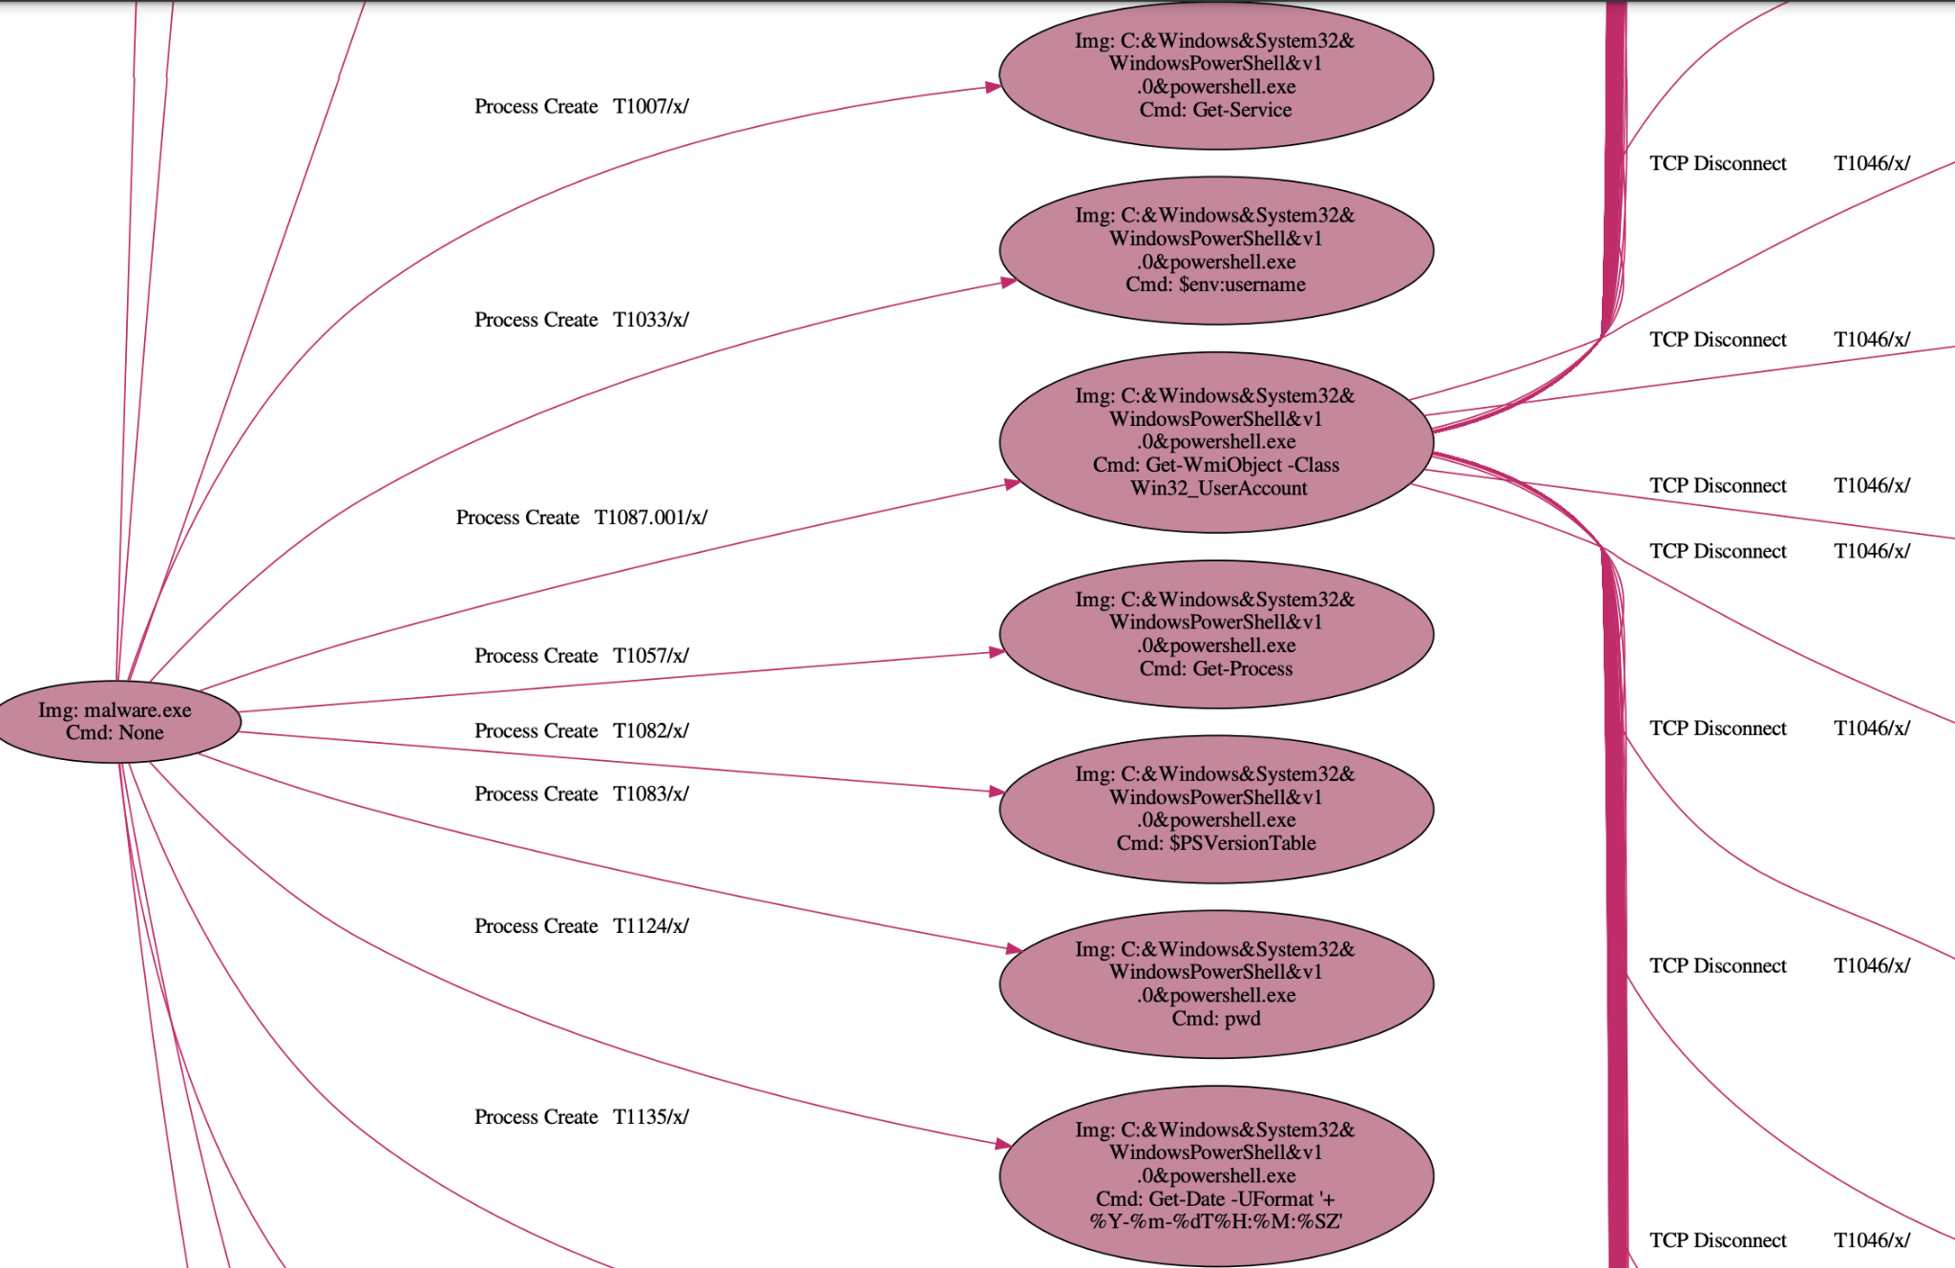
Background: Data Provenance
Given a detected symptom of an attack, cyber analysts can find the root cause of the attack by issuing a backward tracing query on the provenance graph.
Thus, data provenance is a powerful technique for attack attribution.
root cause
Notes:
http://140.109.19.22:8888/files/euni/sigma/result/doctest-output/syn_T1087.001.gv.pdf

Slide 9
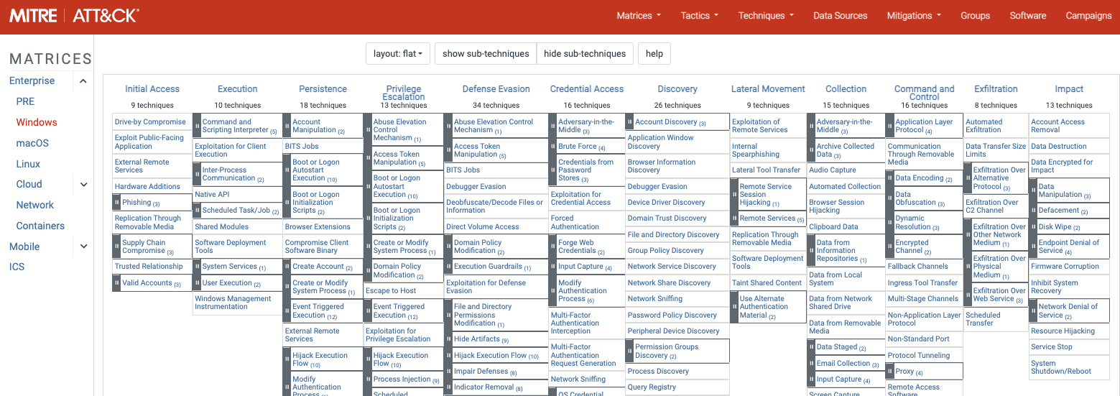
Background: MITRE ATT&CK
MITRE ATT&CK framework is one of the industry’s most curated and globally-accessible knowledge bases of common adversary behavior.
It describes 187 behavioral patterns defined as Techniques observed in the attack campaigns on Windows system.
MITRE ATT&CK for Enterprise, v13, Windows Matrix
Notes:
https://www.cynet.com/blog/learn-how-to-interpret-the-2022-mitre-attck-evaluation-results/
https://attackevals.mitre-engenuity.org/enterprise/
To provide deep visibility into the detected attack
ATT&CK stands for adversarial tactics, techniques and common knowledge—one of the industry’s most curated and globally-accessible knowledge bases of common adversary behavior.

Slide 10
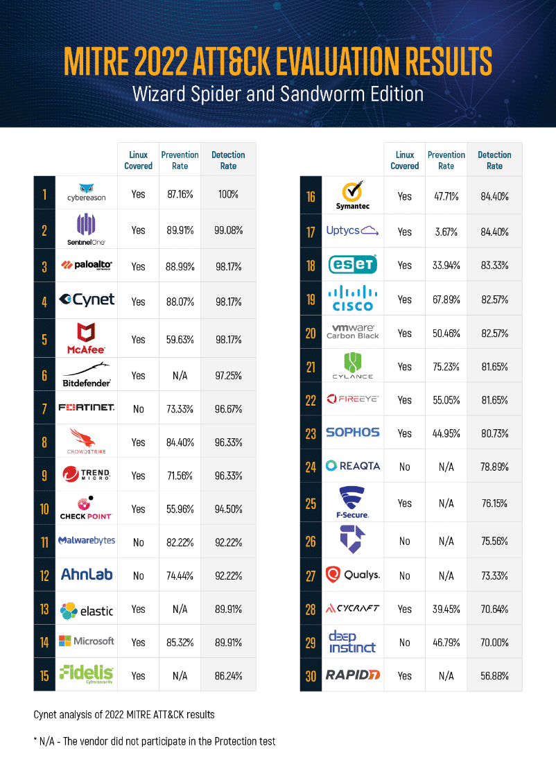
Background: MITRE ATT&CK
In fact, all the top EDR tools leverage the MITRE ATT&CK knowledge base to detect adversary behavior and try to get best score from MITRE Engenuity ATT&CK® Evaluations.
所以我認為能偵測出 technique 是十分有價值的。
Notes:
https://www.cynet.com/blog/learn-how-to-interpret-the-2022-mitre-attck-evaluation-results/
https://attackevals.mitre-engenuity.org/enterprise/
To provide deep visibility into the detected attack
ATT&CK stands for adversarial tactics, techniques and common knowledge—one of the industry’s most curated and globally-accessible knowledge bases of common adversary behavior.

Slide 11
Related Works in Rule(Heuristics-based) provenance analysis
 | Detection Target | Target Labels | Rule Source | Datasets | 備註
Holmes 2019 | Subgraph | APT Stage | Customized | DARPA | high-level scenario graph(HSG) /Severity Score
Rapsheet 2020 | Subgraph | MITRE Technique | Symantec EDR tool | EDR | Tactical Provenance Graph (TPG)
Krystal 2022 | Triplet | MITRE Technique | Sigma | DARPA | transforms Sigma into SPARQL query expressions.
SteinerLog 2022 | Triplet | MITRE Technique | Simga Splunk to MITRE Att&ck Translation Mitre CAR Repository | OpTC(operational teansparent Cyber) | transforms Sigma into Elasticsearch query
Note 1. The existing works can be categorized by the granularity of detection target: Node / Event(Triplet) / Path / Subgraph.

Slide 12
Related Works in ML-based provenance analysis
 | Detection Target | Target Labels | Embedding | Datasets | Attack Label 怎標？ | 備註
Atlas 2021 | Path | Attack / Benign | word representation | Synthesized APT |  | Node-> Triplet->Path
Prographer >2022 | Subgraph | Attack / Benign | graph2vec+ doc2vec | Stream Spot, DARPA TC(C/C/T), ATLAS, Production EDR |  | “Snapshot”
ShadeWatcher 2022 | Path | Attack / Benign | TransR+ GNN | DARPA, Synthesized |  | “Interaction”
Unicorn 2020 | Subgraph | Attack / Benign | Graph Sketching | Stream Spot, DARPA TC(C/C/T), Synthesized
Note 1. The existing works can be categorized by the granularity of detection target: Node / Event(Triplet) / Path / Subgraph.
Note 2. Embedding maps each target to a low-dimensional vector that preserves its key information. Take node as an example, the embedding should preserve the node’s neighborhood information, the node’s structural role. That’s why I take the embedding column into account.
Notes:
https://github.com/crimson-unicorn
Holmes/Nodeze/Poirot
每篇論文的研究流程幾乎都是 a. 將log轉成多個Target（可能先轉成圖）b. 將 Target 轉成 Embedding c. 偵測
Node Embedding: DeepWalk, GCN, GraphStage /
Graph Embedding: DiffPool, graph2vec, graph sketching

Slide 13
Objectives
In this paper, I aim at identifying attacker footprints from audit logs that help cyber analysts precisely locate the MITRE techniques, which can further help them derive the complete attack campaign.
1. Connect to github
T1566.001
Phishing: Spearphishing Attachment
2. Download Phishing Attachment
T1024.002
User Execution: Malicious File
…
T1037.001
Boot or Logon Initialization Scripts: Logon Script (Windows)
Notes:
Initial Access -> Execution -> Persistence
Abstraction from tremendous and low-level log events to interpretable and high-level MITRE technique graphs.
or PROBLEM DEFINITION
compare with related works?
含 DARPA 的 Motivating Example
http://localhost:8080/files/euni/sigma/result/doctest-output/syn_T1087.001.gv.pdf
由於大部分企業以及學校政府機關用的是 Windows，由 windows logs 開始著手
Detect the malicious or suspicious activities by analyzing tremendous log events.

Slide 14
Challenge to Existing Approaches
Statistics-based approaches(e.g., Nodoze, Swift)
Quantify audit records’ degrees of suspicion by their historical frequency.
It fails to differentiate normal records from previously unobserved yet semantically relevant activities => false alarms
Rule-based approaches(e.g., Holmes, RapSheet)
Matching audit records against a knowledge base of security policies
Developing security policies is time-consuming and inevitably requires domain expertise.
Learning-based approaches(e.g., Atlas, ShadeWatcher)
Current learning-based detectors mostly train a model of benign behaviors and detect deviations as cyber-attacks. (Unsupervised Learning)
The lack of labeled data makes it difficult to evaluate the effectiveness of the anomaly detection model accurately.
Most learning-based detectors can only detect two labels of attack/benign, and cannot point out MITER technique.
因為 xxx 原因，所以我的論文實驗了 Rule-based 以及 Learning-based 兩種方法。
Notes:
Statistics-based approaches
Nodoze 2019
Swift 2020
Specification-based(Rule-based) detection
Holmes 2019
RapSheet 2020
Morse
Poirot 2019
Learning-based
Atlas 2021

Slide 15
貢獻
自動化

Slide 16
Issue: How many nodes and relations are enough to represent a MITRE technique in a PG?
以下幾篇論文的最終目標都是找出一個 Graph 來代表一個完整的攻擊事件（該 Graph 包涵多個 Techniques）。這些論文的研究步驟中都需要先找出 Technique，我將其列出來做為參考。
Rule-based Model | The Granularity of a Technique in a PG | Overview(Idea?)
Holmes(2019) | Paths | 利用 information flow dependencies between entities 的概念自定義 rules，這些 rules 可以找出多個 paths 代表一個 Technique，將偵測到的 Techniques 組成 Sequence 變成 High-level Scenario Graph(HSG)。
Rapsheet(2020) | Multiple Triplets | 利用 Symantec EDR tool 提供的 rules 去偵測可以代表 Technique 的 triplets，接著找到 IIP Vertex 組成 IIP Graph，再依照時間序將偵測到的 Techniques 組成 Sequence，變成 Tactical Provenance Graph(TPG)。
Krystal(2022) | Multiple Triplets | 先利用開源的 Sigma Rule 去偵測可以代表 Technique 的 triplets，接著...
SteinerLog(2022) | Multiple Triplets | 先利用開源的 Sigma Rule 去偵測可以代表 Technique 的 triplets，接著...
My work(2023) | Multiple Triplets = Technique Graph | 先利用開源的 Sigma Rule 以及 Deep Learning 的模型去偵測可以代表 Technique 的 triplets，接著將偵測到的 triplets backward trace 用以得到多條 paths，將 paths 合併成一個 graph 代表該 Technique
Notes:
HSG: High-level Scenario Graph
TPG: Tactical Provenance Graph
HOLMES:
They rely on the use of information flow dependencies between entities involved in the TTPs to define rules. These rules lift audit log data to a intermediate layer, which abstracts between concrete audit logs and high-level APT steps.
T1082 https://drive.google.com/file/d/1II8rD4284B7bSwLlw9vJt1HBbF6pmKOt/view?usp=sharing
改成 T1059 的例子

Slide 17
Issue: The Granularity of Detection Target
How many nodes or relations are enough to represent a MITRE technique in a PG?
From the existing works, the granularity of a detection target can be categorized to: 1. Node 2.Triplet(src_node, relation, dst_node) 3.Path 4.Subgraph
DL-based Model | Detection Target | Target Labels | Charact
Atlas(2021) | Node -> Triplet ->Path | Attack / Benign
Prographer(>2022) | Subgraph | Attack / Benign
ShadeWatcher(2021) | Path | Attack / Benign
Unicorn(2020) | Subgraph | Attack / Benign
定義：
detection target /
Target Labels
該論文的假設、概述
自己論文的橫軸
Notes:
T1082 https://drive.google.com/file/d/1II8rD4284B7bSwLlw9vJt1HBbF6pmKOt/view?usp=sharing
改成 T1059 的例子

Slide 18
Observation: From the provenance graphs of our synthesized data, there are one or more triplets corresponded to a Technique. The triplets may form a path or a graph or multiple graphs.
不管它是 path, 或是一個或多個 graph ，我們統一稱這些來自同一個 Technique 的 triplets 所組成的圖形為 Technique Graph。
A Provenance Graph
A Technique Graph(T1078.001)
A Technique Graph(T1070.005)
T1003.002
T1070.005
T1078.001
T1135
T1005
T1046
A Technique Graph(T1003.002)
A Technique Graph(T1046)
Notes:
T1082 https://drive.google.com/file/d/1II8rD4284B7bSwLlw9vJt1HBbF6pmKOt/view?usp=sharing
改成 T1059 的例子

Slide 19
A Motivating Example
T1070.005 Indicator Removal: Network Share Connection Removal
A Provenance Graph
A Technique Graph(T1070.005)
T1070.005
RegQueryValue
ProcessCreate
B
RegSetValue
D
A
ProcessCreate
RegQueryValue
C
RegSetValue
E
A: cmd.exe reg add AutoShareServer REG_DWORD /d 0 && reg add AutoShareWks REG_DWORD /d 0
B: reg.exe reg add AutoShareServer REG_DWORD /d 0
C: reg.exe reg add AutoShareWks REG_DWORD /d 0
D: HKLM\System\...\Parameters\AutoShareServer
E: HKLM\System\...\Parameters\AutoShareWks
Notes:
Tactic: Defense Evasion
駭客要刪掉足跡（defensive indicators），常見足跡像是 strings from downloaded files / logs that are generated from user actions / data analyzed by defenders
005 要刪的足跡主要跟網路分享有關
defensive indicators related to monitored events, such as strings from downloaded files, logs that are generated from user actions, and other data analyzed by defenders.
This is synthesized example.
A:
Img: C:&Windows&system32& cmd.exe
Cmd:
cmd.exe /C
reg add "HKEY_LOCAL_MACHINE\SYSTEM\CurrentControlSet\Services\LanmanServer\Parameters" /v AutoShareServer /t REG_DWORD /d 0 /f &&
reg add "HKEY_LOCAL_MACHINE\SYSTEM\CurrentControlSet\Services\LanmanServer\Parameters" /v AutoShareWks /t REG_DWORD /d 0 /f
B:
Img: C:&Windows&system32& reg.exe
Cmd:
reg add "HKEY_LOCA L_MACHINE&SYSTEM&Cur rentControlSet&Servi ces&LanmanServer&Par ameters" /v AutoShareServer /t REG_DWOR D /d 0 /f
C:
Img: C:&Windows&system32& reg.exe
Cmd:
reg add "HKEY_LOCA L_MACHINE&SYSTEM&Cur rentControlSet&Servi ces&LanmanServer&Par ameters" /v AutoShareWks /t REG_DWORD / d 0 /f
D:
Key: HKLM&System&CurrentC ontrolSet&Services&LanmanServer&Parameters&AutoShareServer
E:
Key: HKLM&System&CurrentControlSet&Services&LanmanServer&Parameters&AutoShareWks

Slide 20
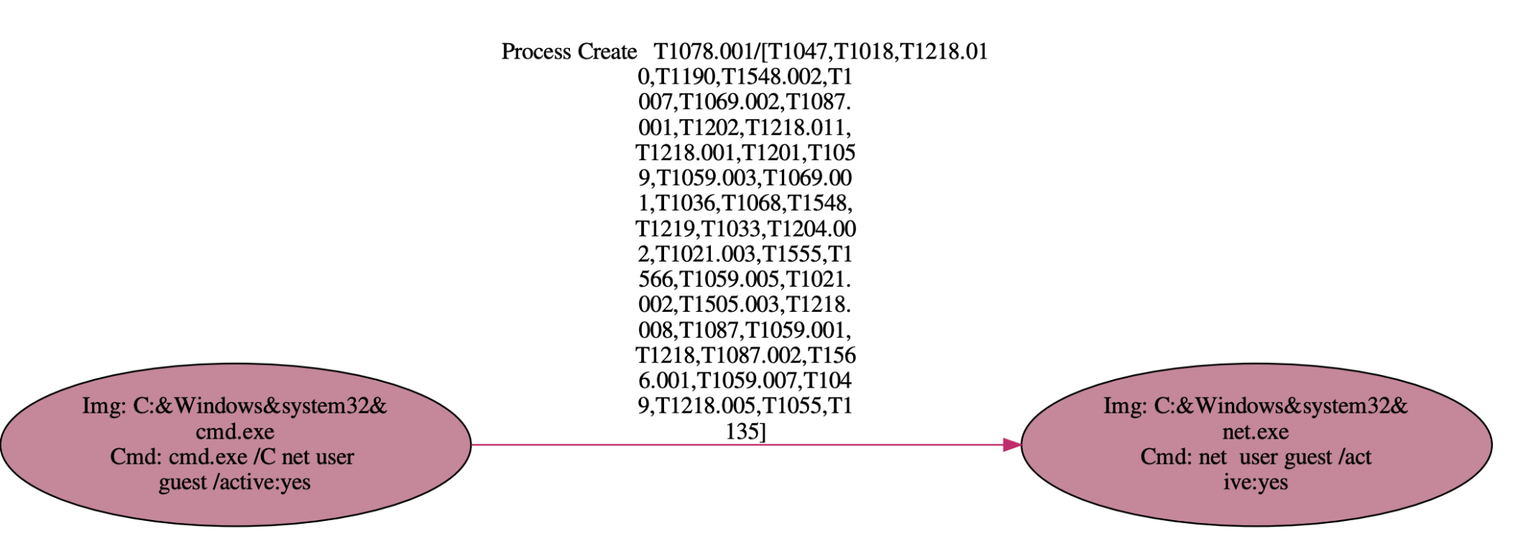
Technique Graph Example - T1078.001
T1078.001: Valid Accounts: Default Accounts
Adversaries may obtain and abuse credentials of a default account.
Procedure Example in MITRE: Magic Hound enabled and used the default system managed account, DefaultAccount, via "powershell.exe" /c net user DefaultAccount /active:yes to connect to a targeted Exchange server over RDP
Process Create

Slide 21
Technique Graph Example - T1003.002
T1003.002: OS Credential Dumping: Security Account Manager(SAM)
Adversaries may attempt to extract credential material from the Security Account Manager (SAM) database through the Windows Registry where the SAM database is stored.
the SAM can be extracted from the Registry with Reg:
reg save HKLM\sam sam
reg save HKLM\system system
QueryBasicInformationFile
CreateFile
CloseFile
WriteFile
Img: reg.exe
Cmd: reg save HKLM\sam C:\Users\...\Local\Temp\sam
\C:\Users\...\Local\Temp\sam
ProcessCreate
QueryBasicInformationFile
CreateFile
CloseFile
WriteFile
ProcessCreate
Img: reg.exe
Cmd: reg save HKLM\security C:\Users\...\Local\Temp\security
\C:\Users\...\Local\Temp\security
cmd.exe
ProcessCreate
QueryBasicInformationFile
CreateFile
CloseFile
WriteFile
Img: reg.exe
Cmd: reg save HKLM\system C:\Users\...\Local\Temp\system
\C:\Users\...\Local\Temp\system
CreateFile
CloseFile
WriteFile
QueryBasicInformationFile
SetBasicInformationFile
powershell.exe
\C:\Users\...\Local\Temp\sam
Notes:
C:\Windows\system32\cmd.exe
C:\Windows\system32\reg.exe
reg save HKLM\sam C:\Users\ezk\AppData\Local\Temp\sam
reg save HKLM\security C:\Users\ezk\AppData\Local\Temp\security
reg save HKLM\system C:\Users\ezk\AppData\Local\Temp\system

Slide 22
Technique Graph Example - T1070.005
T1070.005 Indicator Removal: Network Share Connection Removal
A: cmd.exe reg add AutoShareServer REG_DWORD /d 0 && reg add AutoShareWks REG_DWORD /d 0
B: reg.exe reg add AutoShareServer REG_DWORD /d 0
C: reg.exe reg add AutoShareWks REG_DWORD /d 0
D: HKLM\System\...\Parameters\AutoShareServer
E: HKLM\System\...\Parameters\AutoShareWks
RegQueryValue
ProcessCreate
B
RegSetValue
D
A
ProcessCreate
RegQueryValue
C
RegSetValue
E

Slide 23
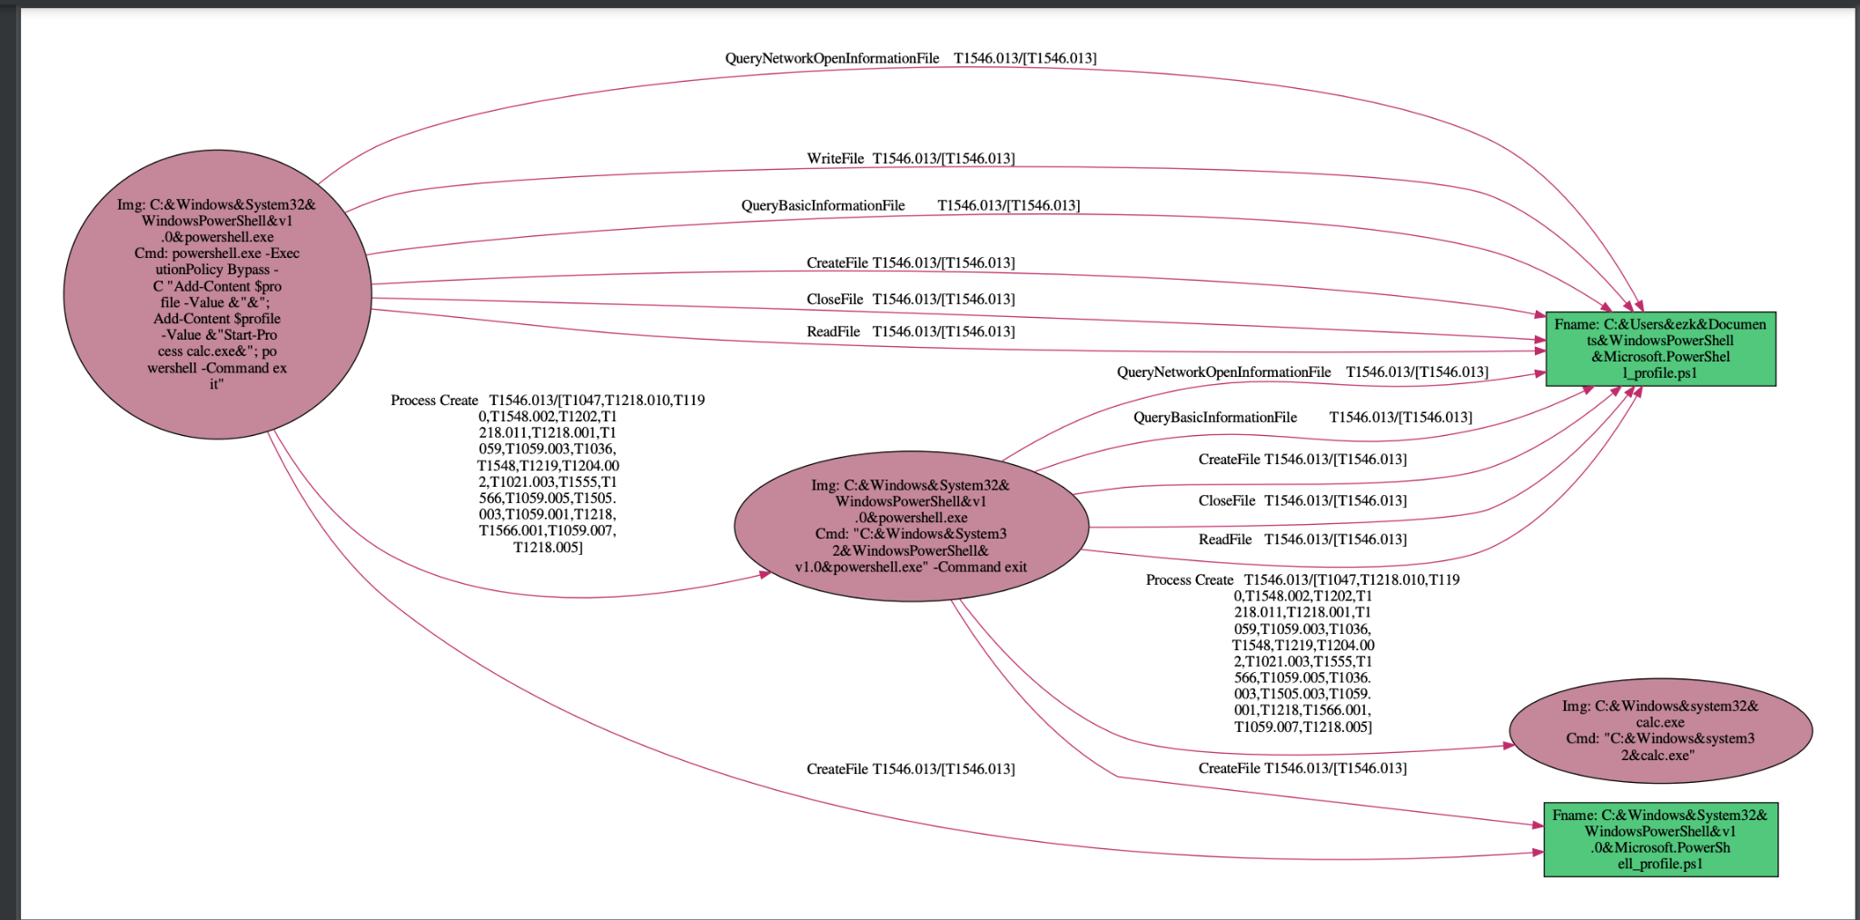
Technique Graph Example - T1546.013
T1546.013: Event Triggered Execution: PowerShell Profile
A PowerShell profiles(profile.ps1) is a script that runs when PowerShell starts and can be used as a logon script to customize user environments
Adversaries may gain persistence and elevate privileges by executing malicious content triggered by PowerShell profiles(profile.ps1).

Slide 24
Problem Definition
定義 Technique Graph
從 audit logs 轉成的 provenance graph 中找到 Technique Graph

Slide 25
研究方法 Approach
Notes:
重點
須清楚交代「研究方法 」，「研究架構」與「實驗設計」

Slide 26
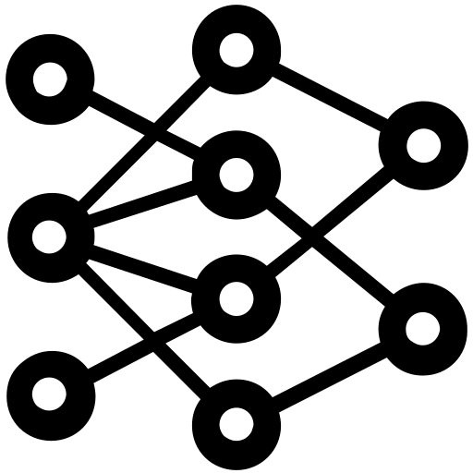




System Architecture
DL-based Method
Triplet
Sementic
Inference
Detection
Model
Training
Provenance Graph Building
Triplets
Embeddings
FFNN
Windows
Audit Logs
Rule-based Method
Triplets / Custom Field Map / Valid Rules
Provenance Graph
registry:
attr:
- OOO: src_ooo - XXX: dst_xxx
relation:
network:
…
Valid Rule
Filter
Multi-process Matcher
selection:
- ZZZ: ^A.*B$
filter:
- XXX: ^(?=.*H)(?=.*I).*$
Triplets
selection:
- ZZZ: ^A.*B$
filter:
- XXX: ^(?=.*H)(?=.*I).*$
Rule
Converter
selection:
- ZZZ: ^A.*B$
filter:
- XXX: ^(?=.*H)(?=.*I).*$
selection:
- ZZZ: ^A.*B$
filter:
- XXX: ^(?=.*H)(?=.*I).*$
Benign
Sigma Rule
(Human readable)
Rule Database
(Machine readable)
T1111
T2222
T1070.005
Technique
Graph
Reconstruction
A Technique Graph
(T1070.005)
Triplets with Technique Label
Notes:
DL Anomaly Detector
Rule Matching Engine 裡面的小模組才是重點，要畫出來

Slide 27
System Architecture
DL-based Method
Triplet
Sementic
Inference
Detection
Model
Training
Provenance Graph Building
Triplets
Embeddings
FFNN
Windows
Audit Logs
Rule-based Method
Triplets / Custom Field Map / Valid Rules
Provenance Graph
registry:
attr:
- OOO: src_ooo - XXX: dst_xxx
relation:
network:
…
Valid Rule
Filter
Multi-process Matcher
selection:
- ZZZ: ^A.*B$
filter:
- XXX: ^(?=.*H)(?=.*I).*$
Triplets
The dataset is…
synthesized, 側錄
selection:
- ZZZ: ^A.*B$
filter:
- XXX: ^(?=.*H)(?=.*I).*$
Rule
Converter
selection:
- ZZZ: ^A.*B$
filter:
- XXX: ^(?=.*H)(?=.*I).*$
selection:
- ZZZ: ^A.*B$
filter:
- XXX: ^(?=.*H)(?=.*I).*$
Benign
Sigma Rule
(Human readable)
Rule Database
(Machine readable)
T1111
T2222
T1070.005
TTP
Graph
Reconstruction
TTP graph
(T1070.005)
Detected TTP Triplets
Notes:
DL Anomaly Detector
Rule Matching Engine 裡面的小模組才是重點，要畫出來

Slide 28
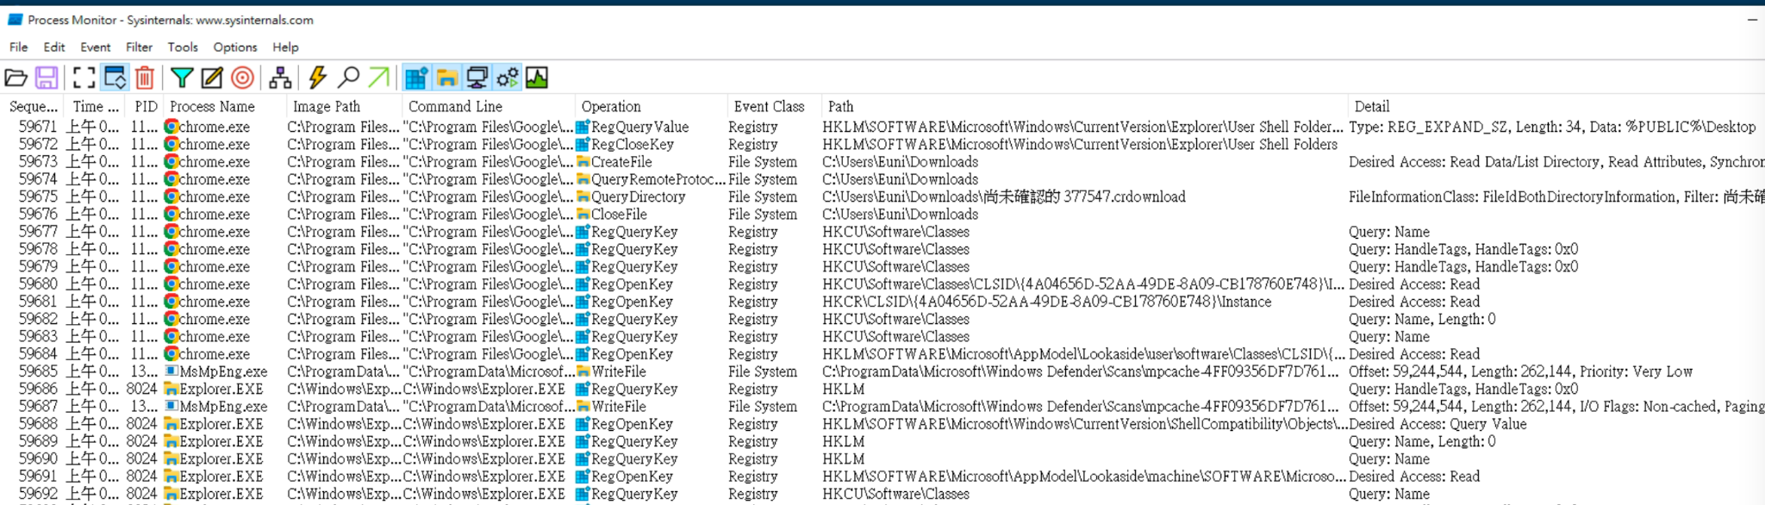
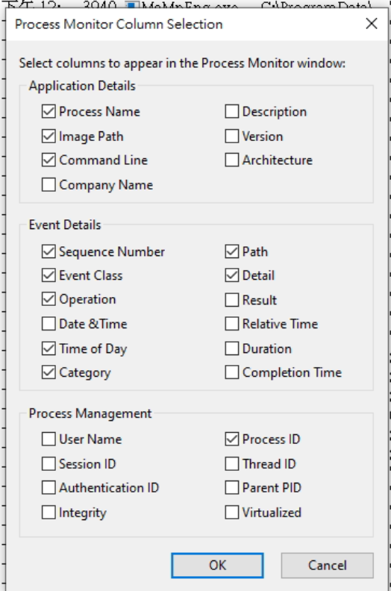
Path
Detail
Sequence
Event Class
Timestamp
Process ID
Operation
Process Name
Image Path
Command Line

Slide 29
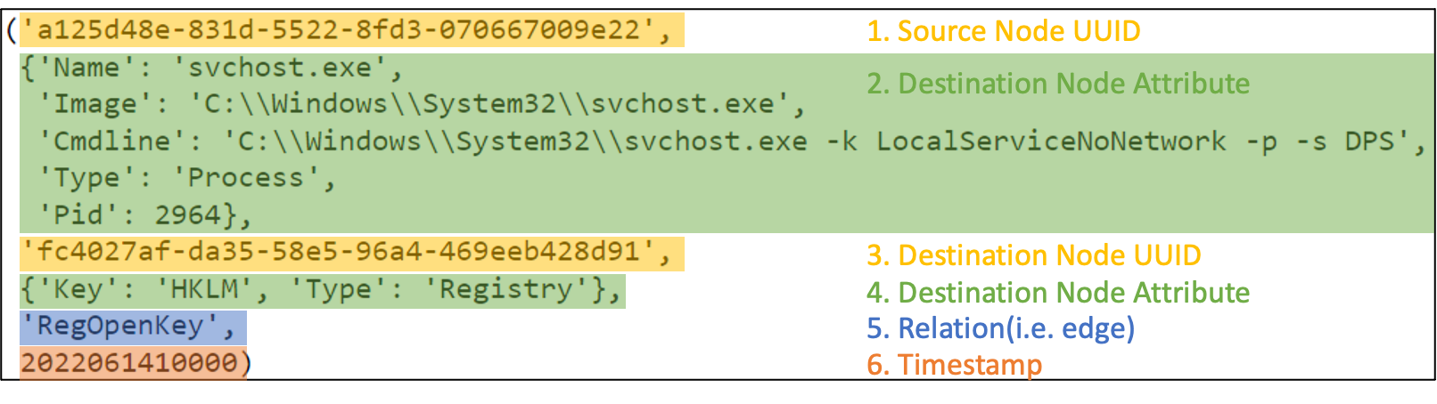
Path
Detail
Sequence
Event Class
Timestamp
Process ID
Operation
實際儲存格式
Process Name
Image Path
Command Line
將該 node 所有的 attributes concat 起來的 string 去 hash 會得到 uuid。

Slide 30
Synthesized 資料集描述
Synthesized 資料集中總事件數量：17,346,525
其中是 TTP 的事件數量：18,334
TTP 的數量是？
各個 TTP 對應的事件數量
其中是 Benign 的事件數量：17,328,191
Entity / Relation 數量

Slide 31
System Architecture
DL-based Method
Triplet
Sementic
Inference
Detection
Model
Training
Provenance Graph Building
Triplets
Embeddings
FFNN
Windows
Audit Logs
Rule-based Method
Triplets / Custom Field Map / Valid Rules
Provenance Graph
registry:
attr:
- OOO: src_ooo - XXX: dst_xxx
relation:
network:
…
Valid Rule
Filter
Multi-process Matcher
selection:
- ZZZ: ^A.*B$
filter:
- XXX: ^(?=.*H)(?=.*I).*$
Triplets
The key idea of this module is to …
selection:
- ZZZ: ^A.*B$
filter:
- XXX: ^(?=.*H)(?=.*I).*$
Rule
Converter
selection:
- ZZZ: ^A.*B$
filter:
- XXX: ^(?=.*H)(?=.*I).*$
selection:
- ZZZ: ^A.*B$
filter:
- XXX: ^(?=.*H)(?=.*I).*$
Benign
Sigma Rule
(Human readable)
Rule Database
(Machine readable)
T1111
T2222
T1070.005
TTP
Graph
Reconstruction
TTP graph
(T1070.005)
Detected TTP Triplets
Notes:
DL Anomaly Detector
Rule Matching Engine 裡面的小模組才是重點，要畫出來

Slide 32
The schema of provenance graph in this paper
Audit logs are represented as data provenance graph where:
Nodes represent system entities (e.g., file, processe, network and registry)
Edges represent system events (i.e., oprations) such as: read, write or connect
Network
'CloseFile',
'CreateFile',
'ReadFile',
'WriteFile',
'SetBasicInformationFile',
'SetDispositionInformationEx',
'SetDispositionInformationFile',
'QueryAllInformationFile',
'QueryAttributeTagFile',
'QueryBasicInformationFile',
'QueryNetworkOpenInformationFile',
'QueryStandardInformationFile',
'QueryDirectory'
'TCP Connect',
'TCP Disconnect',
'TCP Receive',
'TCP Send',
'UDP Receive',
'UDP Send'
'RegCloseKey',
'RegCreateKey',
'RegDeleteValue',
'RegOpenKey',
'RegQueryKey',
'RegQueryValue',
'RegSetValue'
File
Process
Registry
'Process Create'
Process
Notes:
改成 graph schema

Slide 33
Provenance Graph Example

Slide 34
DL-based method
Notes:
重點
須清楚交代「研究方法 」，「研究架構」與「實驗設計」

Slide 35
DL-based
DL-based Method
Triplet
Sementic
Inference
Detection
Model
Training
Provenance Graph Building
Triplets
Embeddings
FFNN
Windows
Audit Logs
Rule-based Method
Triplets / Custom Field Map / Valid Rules
Provenance Graph
registry:
attr:
- OOO: src_ooo - XXX: dst_xxx
relation:
network:
…
Valid Rule
Filter
Multi-process Matcher
selection:
- ZZZ: ^A.*B$
filter:
- XXX: ^(?=.*H)(?=.*I).*$
Triplets
selection:
- ZZZ: ^A.*B$
filter:
- XXX: ^(?=.*H)(?=.*I).*$
Rule
Converter
selection:
- ZZZ: ^A.*B$
filter:
- XXX: ^(?=.*H)(?=.*I).*$
selection:
- ZZZ: ^A.*B$
filter:
- XXX: ^(?=.*H)(?=.*I).*$
Benign
Sigma Rule
(Human readable)
Rule Database
(Machine readable)
T1111
T2222
T1070.005
TTP
Graph
Reconstruction
TTP graph
(T1070.005)
Detected TTP Triplets
Notes:
DL Anomaly Detector
Rule Matching Engine 裡面的小模組才是重點，要畫出來

Slide 36
Triplet Sementic Inference
DL-based Method
Triplet
Sementic
Inference
Detection
Model
Training
Provenance Graph Building
Triplets
Embeddings
FFNN
Windows
Audit Logs
Rule-based Method
Triplets / Custom Field Map / Valid Rules
Provenance Graph
registry:
attr:
- OOO: src_ooo - XXX: dst_xxx
relation:
network:
…
Valid Rule
Filter
Multi-process Matcher
selection:
- ZZZ: ^A.*B$
filter:
- XXX: ^(?=.*H)(?=.*I).*$
The key idea of this module is to embed components of a KG including entities and relations into continuous vector spaces. Those entity and relation embeddings can further be used to train the FFNN model while preserving the inherent structure of the KG.
Triplets
selection:
- ZZZ: ^A.*B$
filter:
- XXX: ^(?=.*H)(?=.*I).*$
Rule
Converter
selection:
- ZZZ: ^A.*B$
filter:
- XXX: ^(?=.*H)(?=.*I).*$
selection:
- ZZZ: ^A.*B$
filter:
- XXX: ^(?=.*H)(?=.*I).*$
Benign
Sigma Rule
(Human readable)
Rule Database
(Machine readable)
T1111
T2222
T1070.005
TTP
Graph
Reconstruction
TTP graph
(T1070.005)
Detected TTP Triplets
Notes:
DL Anomaly Detector
Rule Matching Engine 裡面的小模組才是重點，要畫出來

Slide 37
Triplet Sementic Inference
Suppose we are given a KG consisting of n entities and m relations. Facts observed in the KG are stored as a collection of triplets D+ = {(h, r, t)}. Each triplet is composed of a head entity h ∈ E, a tail entity t ∈ E, and a relation r∈R between them, e.g., (A, B, C). Here, E denotes the set of entities, and R the set of relations.
A typical KG embedding technique generally consists of three steps:
representing entities and relations
defining a scoring function
learning entity and relation representations.

Slide 38
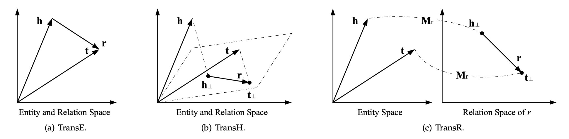
Triplet Sementic Inference
A typical KG embedding technique generally consists of three steps:
(i) representing entities and relations
Entities are usually represented as vectors, i.e., deterministic points in the vector space
Relations are typically taken as operations in the vector space, which can be represented as vectors(TransE, TransH) , matrices(TransR, SME), tensors(NTN), multivariate Gaussian distributions(KG2E) , or even mixtures of Gaussians(TransG).
Notes:
14 TransE
15 TransH
16 TransR
18 SME
19 Neural Tensor Network (NTN).
45 KG2E represents entities and relations as random vectors drawn from multivariate Gaussian distributions
46 TransG

Slide 39
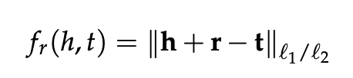
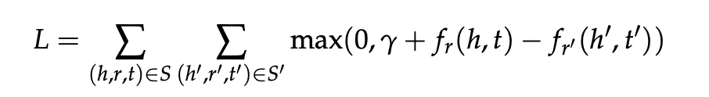
A typical KG embedding technique generally consists of three steps:
(i) representing entities and relations
(ii) defining a scoring function
a scoring function fr(h,t) is defined on each fact (h, r, t) to measure its plausibility.
(iii) learning entity and relation representations.
solves an optimization problem that maximizes the total plausibility of observed facts (i.e., facts contained in D+).
Define a loss function with the scoring function
S′: corrupted triplet set

Slide 40
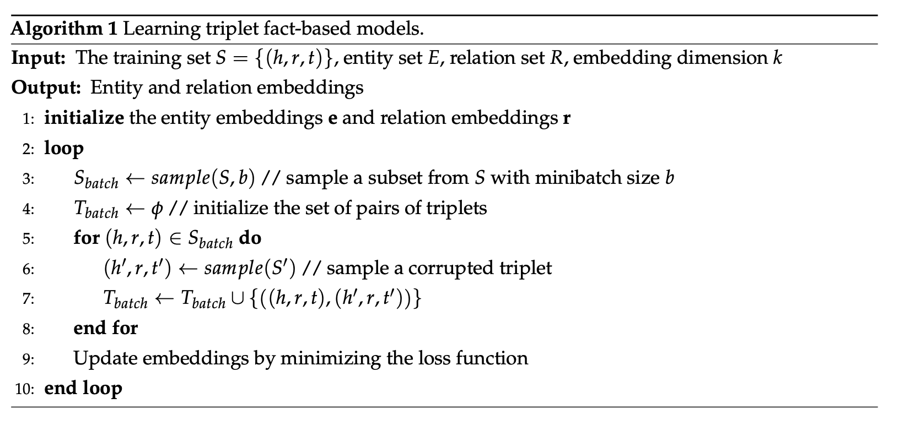
(iii) learning entity and relation representations.

Slide 41
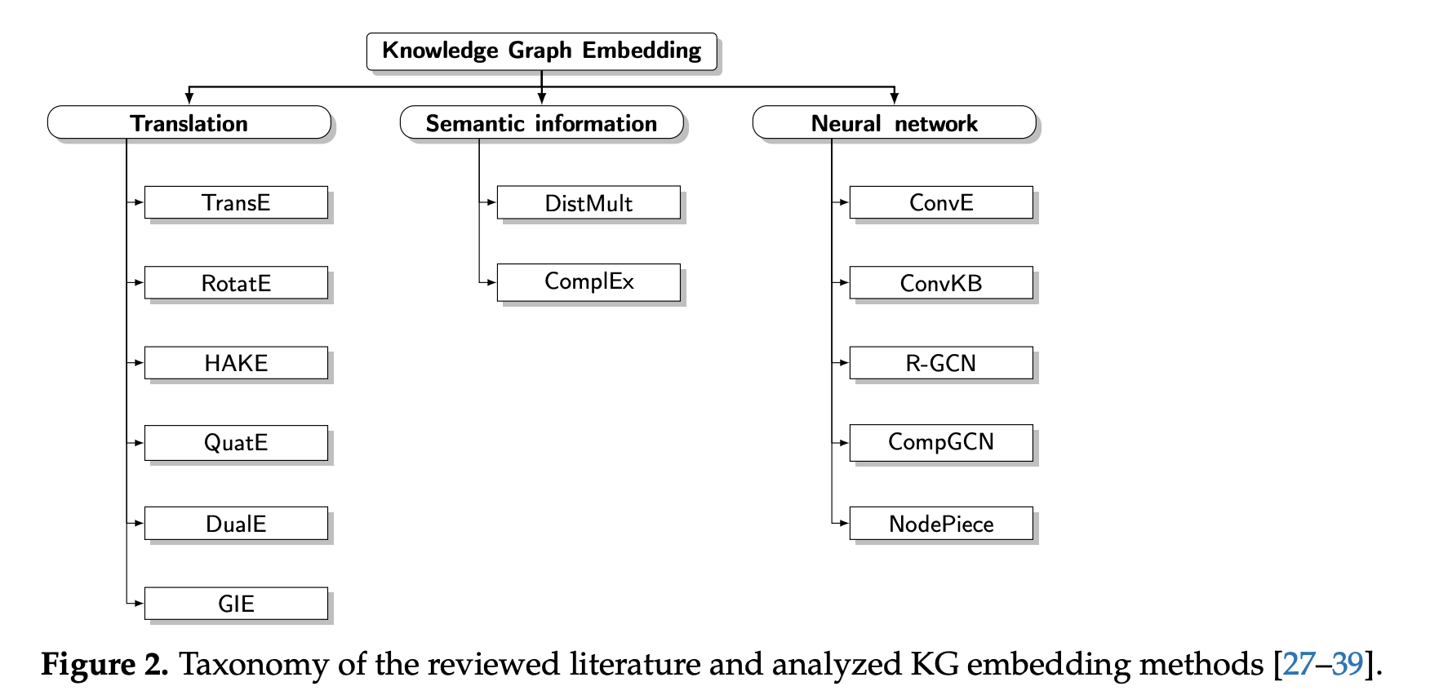
Representative Knowledge Graph Embedding Methods
RESCAL
HolE
ANALOGY
…
KEPLER
Notes:
Comprehensive Analysis of Knowledge Graph Embedding Techniques Benchmarked on Link Prediction

Slide 42
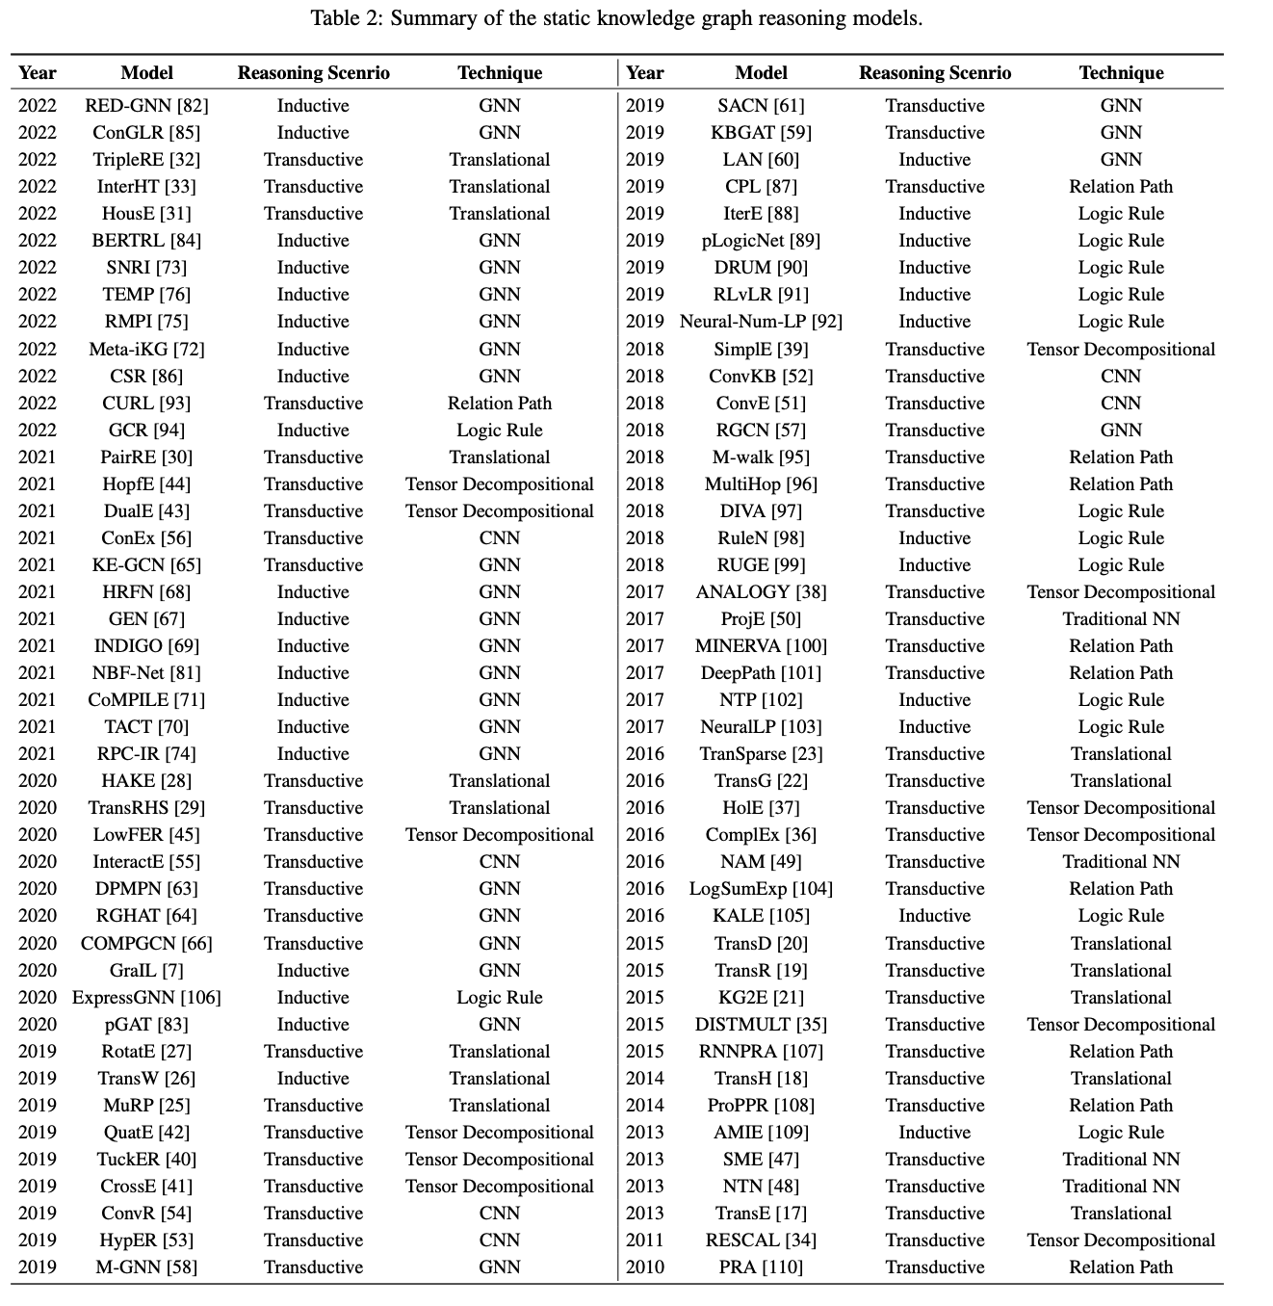

Slide 43
解釋分類
Translation Distance Models
They measure the plausibility of a fact as the distance between the two entities, usually after a translation carried out by the relation.
The scoring function is then defined as the (negative) distance between h + r and t
Semantic Matching Models
They measure plausibility of facts by matching latent semantics of entities and relations embodied in their vector space representations.
Graph Neural Network-based Models
Notes:
Algorithm =>
Training under Open World Assumption => Knowledge Graph Embedding: A Survey of Approaches and Applications
Learning triplet fact-based models. => A Survey on Knowledge Graph Embedding: Approaches, Applications and Benchmarks
embedding model 三步驟 => Knowledge Graph Embedding: A Survey of Approaches and Applications
A typical KG embedding technique generally consists of three steps:
(i) representing entities and relations,
(ii) defin- ing a scoring function, and
(iii) learning entity and relation representations.

Slide 44
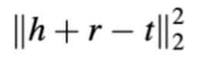
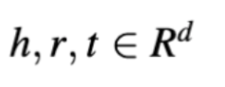
Choose 2~3 models in each categories
Category | Model | citation | Scoring func | loss func | Embedding Dimension | Characteristics
Translation Distance Models | TransE(2013) | 6772 |  |  |  | first and classic
 | TransR(2015) | 3380 |  |  |  | Mapping different relationships to different semantic spaces
semantic matching models | DistMult(2014) | 2611
 | ComplEx(2016) | 2412
NN-based Model | R-GCN(2018) | 3583
 | CompGCN(2020) | 530
 | KEPLER(2021) | 351 |  |  |  | Pretrained NN
Notes:
Characteristics => https://ieeexplore.ieee.org/stamp/stamp.jsp?tp=&arnumber=9220143 Knowledge Graph Completion: A Review

Slide 45
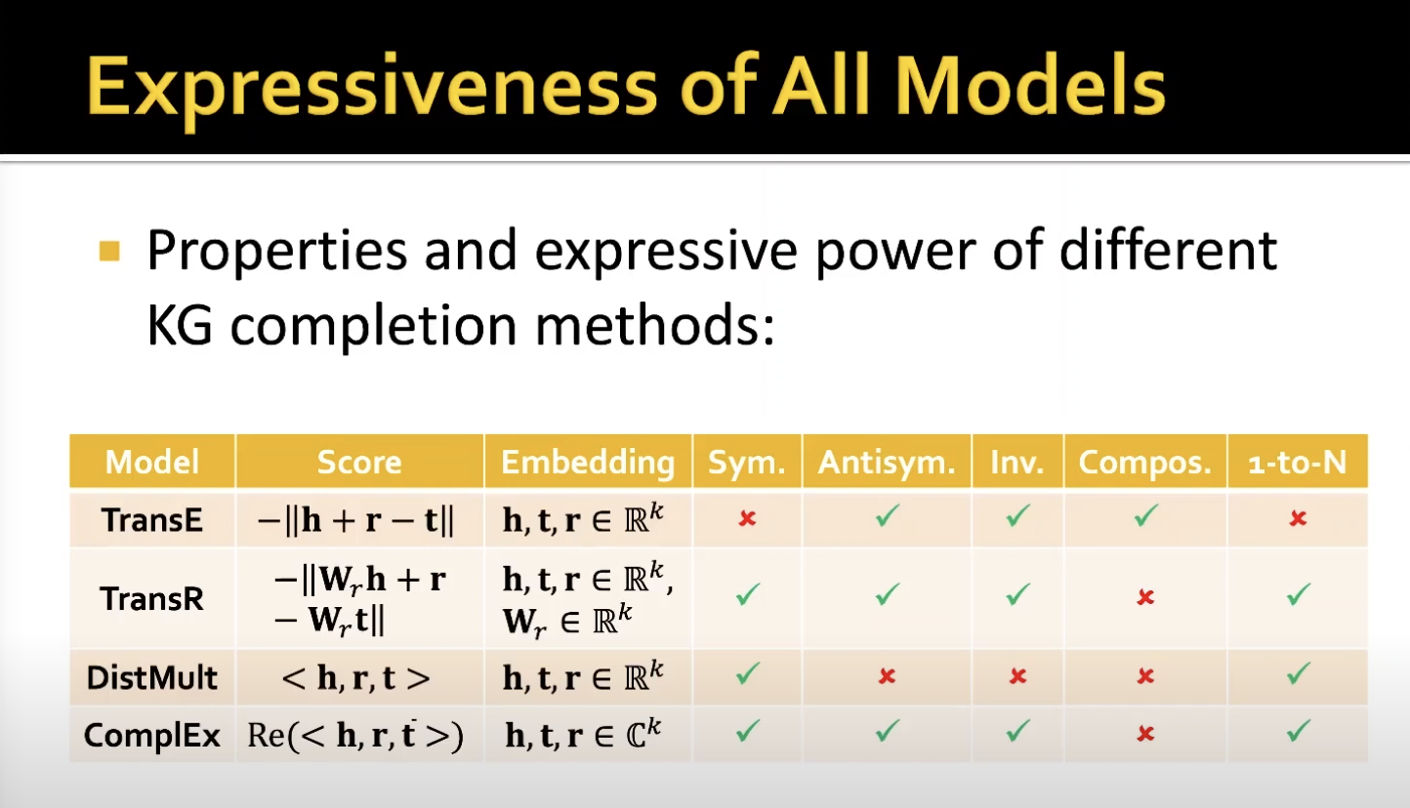
How to evaluate embeddings?
by 模型解釋力
1toN
Relation Space != Entity Space
Composition
by Downstream Tasks

Slide 46
How to evaluate embeddings?
by Downstream Tasks
what is downstream tasks?

Slide 47
Detection Model Training
DL-based Method
Triplet
Sementic
Inference
Detection
Model
Training
Provenance Graph Building
Triplets
Embeddings
FFNN
Windows
Audit Logs
Rule-based Method
Triplets / Custom Field Map / Valid Rules
Provenance Graph
registry:
attr:
- OOO: src_ooo - XXX: dst_xxx
relation:
network:
…
Valid Rule
Filter
Multi-process Matcher
selection:
- ZZZ: ^A.*B$
filter:
- XXX: ^(?=.*H)(?=.*I).*$
The key idea of this module is to...
Triplets
selection:
- ZZZ: ^A.*B$
filter:
- XXX: ^(?=.*H)(?=.*I).*$
Rule
Converter
selection:
- ZZZ: ^A.*B$
filter:
- XXX: ^(?=.*H)(?=.*I).*$
selection:
- ZZZ: ^A.*B$
filter:
- XXX: ^(?=.*H)(?=.*I).*$
Benign
Sigma Rule
(Human readable)
Rule Database
(Machine readable)
T1111
T2222
T1070.005
TTP
Graph
Reconstruction
TTP graph
(T1070.005)
Detected TTP Triplets
Notes:
DL Anomaly Detector
Rule Matching Engine 裡面的小模組才是重點，要畫出來

Slide 48
Rule-based method
Notes:
重點
須清楚交代「研究方法 」，「研究架構」與「實驗設計」

Slide 49
Rule-based
DL-based Method
Triplet
Sementic
Inference
Detection
Model
Training
Provenance Graph Building
Triplets
Embeddings
FFNN
Windows
Audit Logs
Rule-based Method
Triplets / Custom Field Map / Valid Rules
Provenance Graph
registry:
attr:
- OOO: src_ooo - XXX: dst_xxx
relation:
network:
…
Valid Rule
Filter
Multi-process Matcher
selection:
- ZZZ: ^A.*B$
filter:
- XXX: ^(?=.*H)(?=.*I).*$
Triplets
selection:
- ZZZ: ^A.*B$
filter:
- XXX: ^(?=.*H)(?=.*I).*$
Rule
Converter
selection:
- ZZZ: ^A.*B$
filter:
- XXX: ^(?=.*H)(?=.*I).*$
selection:
- ZZZ: ^A.*B$
filter:
- XXX: ^(?=.*H)(?=.*I).*$
Benign
Sigma Rule
(Human readable)
Rule Database
(Machine readable)
T1111
T2222
T1070.005
TTP
Graph
Reconstruction
TTP graph
(T1070.005)
Detected TTP Triplets
Notes:
DL Anomaly Detector
Rule Matching Engine 裡面的小模組才是重點，要畫出來

Slide 50
Sigma
DL-based Method
Triplet
Sementic
Inference
Detection
Model
Training
What is Sigma?
How much Sigma rules collected?
Provenance Graph Building
Triplets
Embeddings
FFNN
Windows
Audit Logs
Rule-based Method
Triplets / Custom Field Map / Valid Rules
Provenance Graph
registry:
attr:
- OOO: src_ooo - XXX: dst_xxx
relation:
network:
…
Valid Rule
Filter
Multi-process Matcher
selection:
- ZZZ: ^A.*B$
filter:
- XXX: ^(?=.*H)(?=.*I).*$
Triplets
selection:
- ZZZ: ^A.*B$
filter:
- XXX: ^(?=.*H)(?=.*I).*$
Rule
Converter
selection:
- ZZZ: ^A.*B$
filter:
- XXX: ^(?=.*H)(?=.*I).*$
selection:
- ZZZ: ^A.*B$
filter:
- XXX: ^(?=.*H)(?=.*I).*$
Benign
Sigma Rule
(Human readable)
Rule Database
(Machine readable)
T1111
T2222
T1070.005
TTP
Graph
Reconstruction
TTP graph
(T1070.005)
Detected TTP Triplets
Notes:
DL Anomaly Detector
Rule Matching Engine 裡面的小模組才是重點，要畫出來

Slide 51
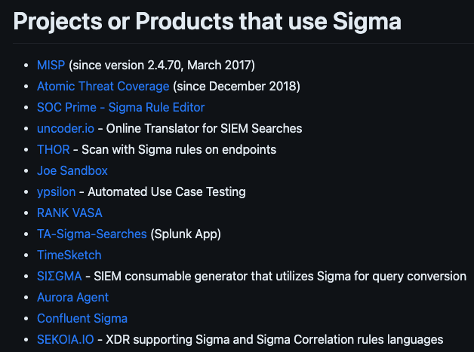
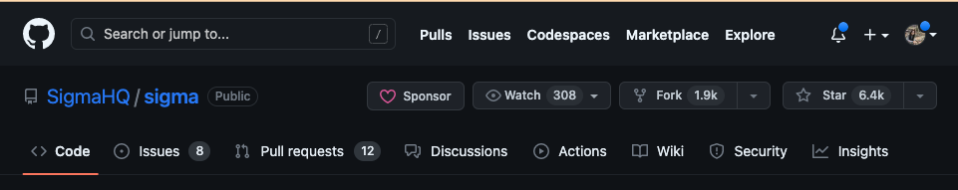
Why we study Sigma?
Sigma is a generic and open signature format that allows you to describe relevant log events in a straightforward manner. The rule format is very flexible, easy to write and applicable to any type of log file. The main purpose of this project is to provide a structured form in which researchers or analysts can describe their once developed detection methods and make them shareable with others.
Open Source
Active Community
星星數和產品數都很高
Notes:
https://github.com/SigmaHQ/sigma

Slide 52
A Sigma Rule Example
T1070.005: Indicator Removal: Network Share Connection Removal
Rule Source: registry_set_disable_administrative_share.yml
title: Disable Administrative Share Creation at Startup
status: test
description: Administrative shares are hidden network shares created by Microsoft Windows NT operating systems that grant system administrators remote access to every disk volume on a network-connected system
tags:
- attack.defense_evasion
- attack.t1070.005
logsource:
category: registry_set
product: windows
detection:
selection:
EventType: SetValue
TargetObject|startswith: 'HKLM\System\CurrentControlSet\Services\LanmanServer\Parameters\'
TargetObject|endswith:
- 'AutoShareWks'
- 'AutoShareServer'
Details: 'DWORD (0x00000000)'
condition: selection
level: medium
stable / test / experimental / deprecated / unsupported
The rules consist of a many sections, including
title
status
description
tags
logsource
detection
level
Notes:
https://github.com/SigmaHQ/sigma-specification/blob/main/Sigma_specification.md#status-optional

Slide 53
Converter
DL-based Method
Triplet
Sementic
Inference
Detection
Model
Training
The key idea of this module is to convert all collected Sigma rules from human-readable to machine readable detection rules.
(Handle condition string / Regex)
Provenance Graph Building
Triplets
Embeddings
FFNN
Windows
Audit Logs
Rule-based Method
Triplets / Custom Field Map / Valid Rules
Provenance Graph
registry:
attr:
- OOO: src_ooo - XXX: dst_xxx
relation:
network:
…
Valid Rule
Filter
Multi-process Matcher
selection:
- ZZZ: ^A.*B$
filter:
- XXX: ^(?=.*H)(?=.*I).*$
Triplets
selection:
- ZZZ: ^A.*B$
filter:
- XXX: ^(?=.*H)(?=.*I).*$
Rule
Converter
selection:
- ZZZ: ^A.*B$
filter:
- XXX: ^(?=.*H)(?=.*I).*$
selection:
- ZZZ: ^A.*B$
filter:
- XXX: ^(?=.*H)(?=.*I).*$
Benign
Sigma Rule
(Human readable)
Rule Database
(Machine readable)
T1111
T2222
T1070.005
TTP
Graph
Reconstruction
TTP graph
(T1070.005)
Detected TTP Triplets
Notes:
DL Anomaly Detector
Rule Matching Engine 裡面的小模組才是重點，要畫出來

Slide 54
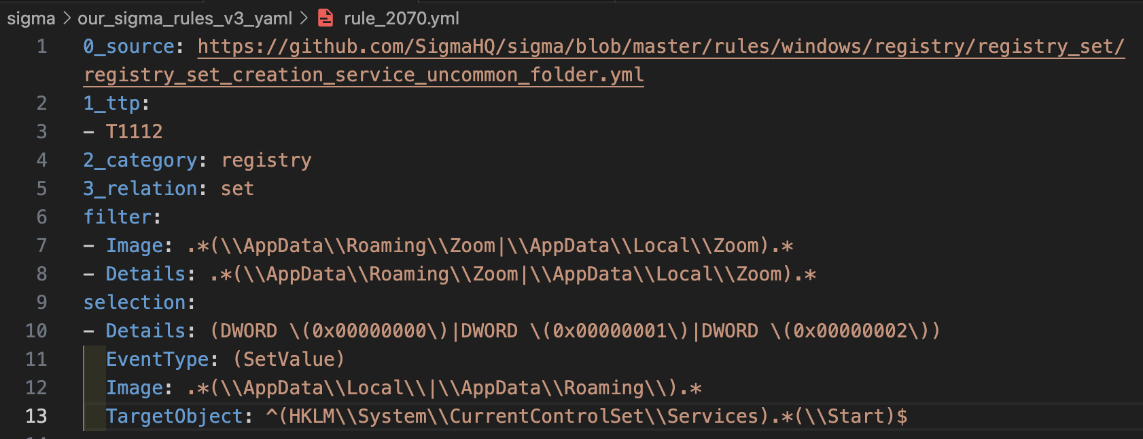
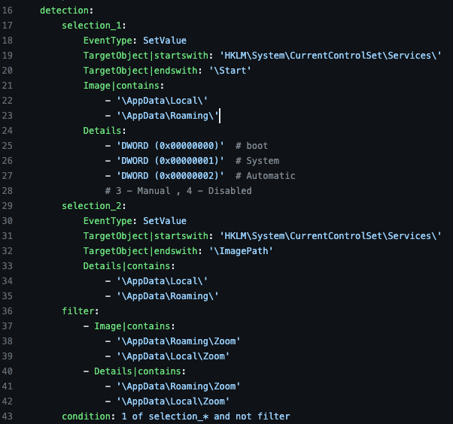
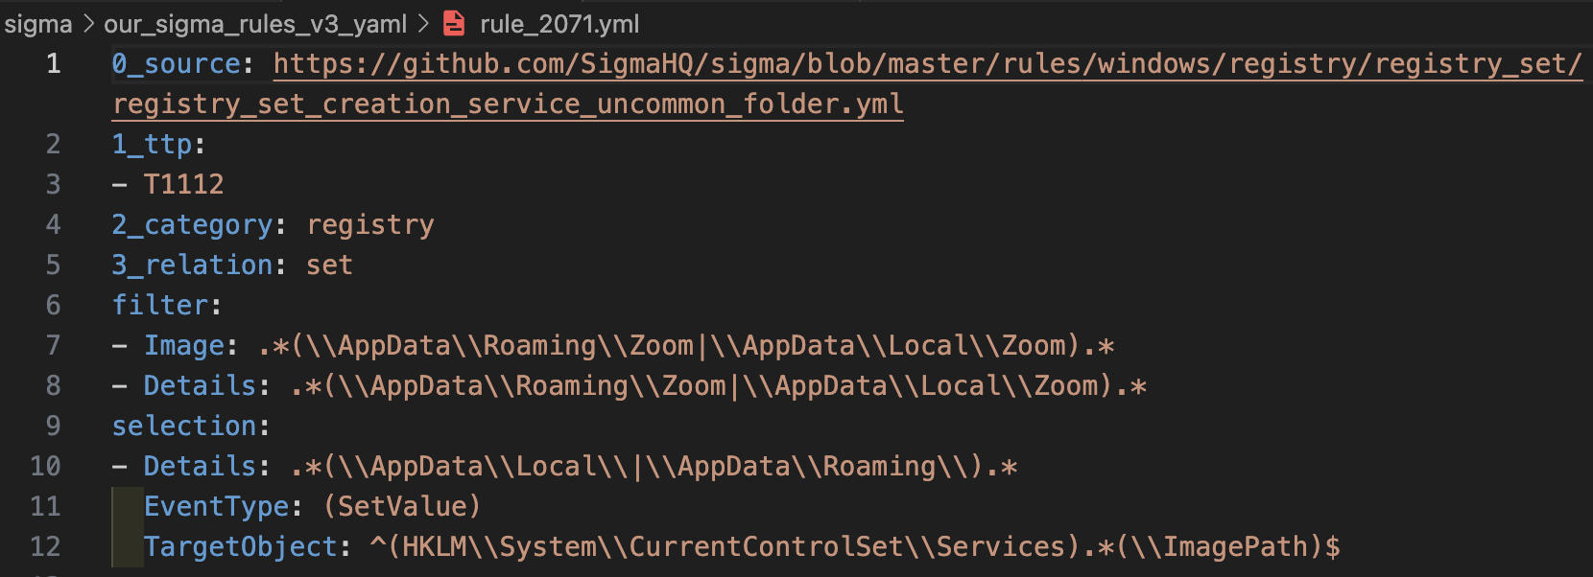
Converter Input: 1 sigma rule
Converter Output: 2 detection rules
registry_set_creation_service_uncommon_folder.yml

Slide 55
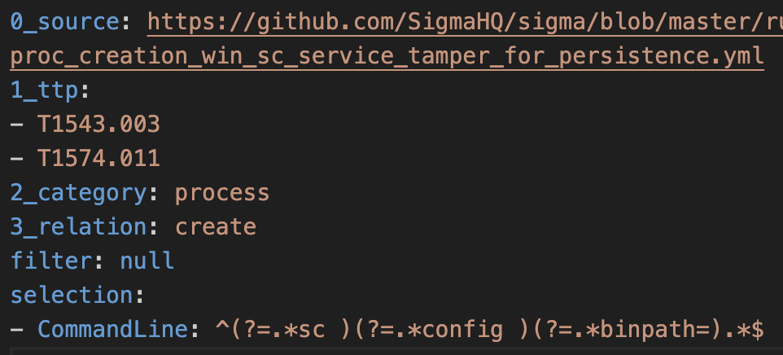
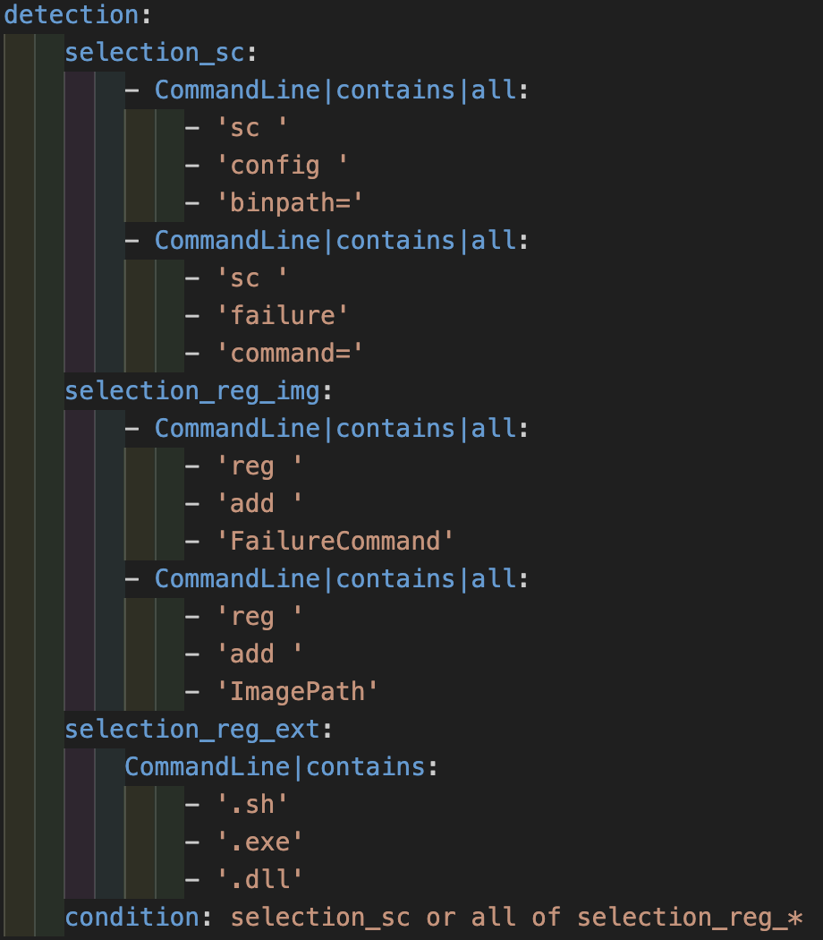
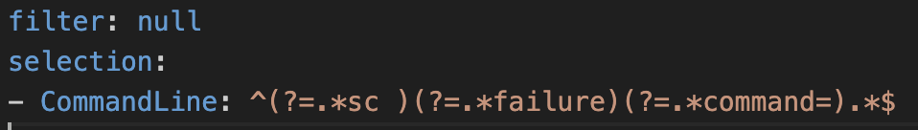
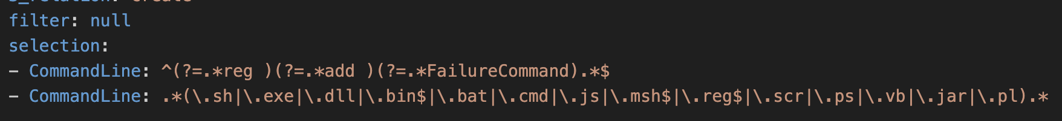
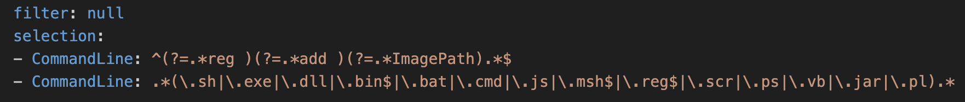
Converter Input: 1 sigma rule
Converter Output: 4 detection rules
proc_creation_win_sc_service_tamper_for_persistence.yml

Slide 56
Filter
DL-based Method
The key idea of this module is to
Triplet
Sementic
Inference
Detection
Model
Training
Provenance Graph Building
Triplets
Embeddings
FFNN
Windows
Audit Logs
Rule-based Method
Triplets / Custom Field Map / Valid Rules
Provenance Graph
registry:
attr:
- OOO: src_ooo - XXX: dst_xxx
relation:
network:
…
Valid Rule
Filter
Multi-process Matcher
selection:
- ZZZ: ^A.*B$
filter:
- XXX: ^(?=.*H)(?=.*I).*$
Triplets
selection:
- ZZZ: ^A.*B$
filter:
- XXX: ^(?=.*H)(?=.*I).*$
Rule
Converter
selection:
- ZZZ: ^A.*B$
filter:
- XXX: ^(?=.*H)(?=.*I).*$
selection:
- ZZZ: ^A.*B$
filter:
- XXX: ^(?=.*H)(?=.*I).*$
Benign
Sigma Rule
(Human readable)
Rule Database
(Machine readable)
T1111
T2222
T1070.005
TTP
Graph
Reconstruction
TTP graph
(T1070.005)
Detected TTP Triplets
Notes:
DL Anomaly Detector
Rule Matching Engine 裡面的小模組才是重點，要畫出來

Slide 57
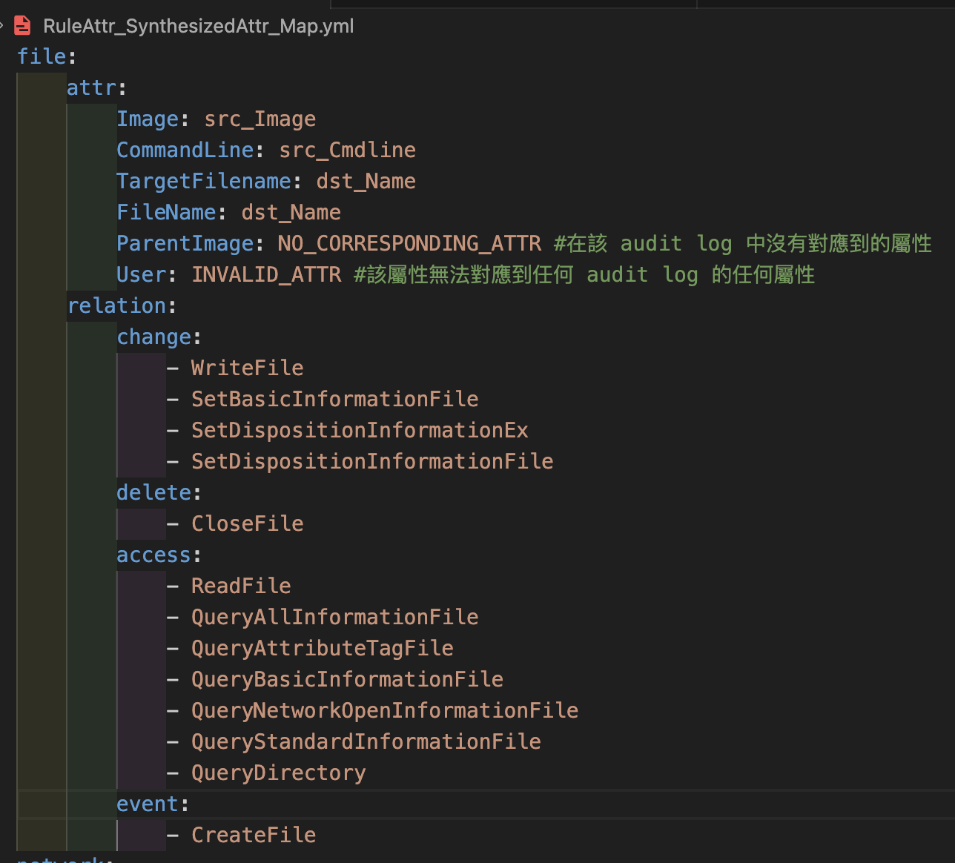
Filter
INVALID ATTR 數量：25
ParentUser / sha256 / Details / CallTrace…
NO CORR ATTR(Synthesized) 數量：2
ParentCommandLine / ParentImage
NO CORR ATTR(DARPA) 數量：7
SourceHostname / Image / TargetImage / DestinationHostname / SourceImage / ParentCommandLine / ParentImage'
無效(Invalid)規則定義：
* 沒有 TTP
* 如果所有 selection 裡面的所有屬性都是INVALID_ATTR
無用(Useless) 規則定義
* 如果所有 selection 裡面的屬性都是 NO_CORRESPONDING_ATTR
* 如果所有 filter 裡面的屬性都是 NO_CORRESPONDING_ATTR
* 如果沒有對應的 relation
* 如果 dst node 沒有對應的屬性

Slide 58
補： invalid rule 例子
補： useless rule(Synthesize) 例子
補： useless rule(Darpa) 例子

Slide 59
Matcher
DL-based Method
Triplet
Sementic
Inference
Detection
Model
Training
The key idea of this module is to
Provenance Graph Building
Triplets
Embeddings
FFNN
Windows
Audit Logs
Rule-based Method
Triplets / Custom Field Map / Valid Rules
Provenance Graph
registry:
attr:
- OOO: src_ooo - XXX: dst_xxx
relation:
network:
…
Valid Rule
Filter
Multi-process Matcher
selection:
- ZZZ: ^A.*B$
filter:
- XXX: ^(?=.*H)(?=.*I).*$
Triplets
selection:
- ZZZ: ^A.*B$
filter:
- XXX: ^(?=.*H)(?=.*I).*$
Rule
Converter
selection:
- ZZZ: ^A.*B$
filter:
- XXX: ^(?=.*H)(?=.*I).*$
selection:
- ZZZ: ^A.*B$
filter:
- XXX: ^(?=.*H)(?=.*I).*$
Benign
Sigma Rule
(Human readable)
Rule Database
(Machine readable)
T1111
T2222
T1070.005
TTP
Graph
Reconstruction
TTP graph
(T1070.005)
Detected TTP Triplets
Notes:
DL Anomaly Detector
Rule Matching Engine 裡面的小模組才是重點，要畫出來

Slide 60
Workflow of Ruled-based Detection(1/2)
Converter: Handle condition string / Regex
Filter: Find useful and valid rules with custom field mapping
3. Matcher: Multi-process detect TTP with all useful rules
tags:
- attack.t1070.005
logsource:
category: registry_set
selection_1:
- ZZZ|startswith: A ZZZ|endtswith: B
- OOO|startswith: C OOO|contains:
- D - E
selection_2:
XXX|startswith: F VVV|contains: G
filterA:
XXX|contains|all:
- H - I
filterB:
- XXX: J
- OOO|endswith:
- K
- L
condition: 1 of selection_* and not 1 of filter*
A
B
selection:
- ZZZ: ^A.*B$
filter:
- XXX: ^(?=.*H)(?=.*I).*$
- XXX: J
- OOO: ^.*(K|L)$
selection:
- OOO: ^C.*(D|E).*$
filter:
- XXX: ^(?=.*H)(?=.*I).*$
- XXX: J
- OOO: .*(K|L)$
Converter
B
Filter
C
selection:
- OOO: ^C.*(D|E).*$
filter:
- XXX: ^(?=.*H)(?=.*I).*$
- XXX: J
- OOO: .*(K|L)$
selection:
- XXX: ^F.*$ - VVV: ^.*(G).*$
filter:
- XXX: ^(?=.*H)(?=.*I).*$
- XXX: J
- OOO: .*(K|L)$
C
selection:
- XXX: ^F.*$ - VVV: ^.*(G).*$
filter:
- XXX: ^(?=.*H)(?=.*I).*$
- XXX: J
- OOO: .*(K|L)$
registry:
attr:
- OOO: src_ooo - XXX: dst_xxx
relation:
network:
…
Detection Rule
(Machine readable)
Sigma Rule Format(Human readable)
Notes:
拆成 src/dst node 的判斷、刪無ttp的
右邊 matching 要畫出 queue 的格式
收集到幾個 rule，其中幾個有效，幾個有用，轉換後幾個
Challenges for Sigma Rule Converter:
Complicated condition string：涵括好
Regex
ugly condition
deprecated ‘re’, …
exception

Slide 61
System Architecture
DL-based Method
Triplet
Sementic
Inference
Detection
Model
Training
Provenance Graph Building
Triplets
Embeddings
FFNN
The key idea of this module is to …
Windows
Audit Logs
Rule-based Method
Triplets / Custom Field Map / Valid Rules
Provenance Graph
registry:
attr:
- OOO: src_ooo - XXX: dst_xxx
relation:
network:
…
Valid Rule
Filter
Multi-process Matcher
selection:
- ZZZ: ^A.*B$
filter:
- XXX: ^(?=.*H)(?=.*I).*$
Triplets
selection:
- ZZZ: ^A.*B$
filter:
- XXX: ^(?=.*H)(?=.*I).*$
Rule
Converter
selection:
- ZZZ: ^A.*B$
filter:
- XXX: ^(?=.*H)(?=.*I).*$
selection:
- ZZZ: ^A.*B$
filter:
- XXX: ^(?=.*H)(?=.*I).*$
Benign
Sigma Rule
(Human readable)
Rule Database
(Machine readable)
T1111
T2222
T1070.005
TTP
Graph
Reconstruction
TTP graph
(T1070.005)
Detected TTP Triplets
Notes:
DL Anomaly Detector
Rule Matching Engine 裡面的小模組才是重點，要畫出來

Slide 62
實驗設計＆評估
Notes:
重點
須清楚交代「研究方法 」，「研究架構」與「實驗設計」

Slide 63
Triplet Sementic Inference
DL-based Method
Triplet
Sementic
Inference
Detection
Model
Training
Provenance Graph Building
Triplets
Embeddings
FFNN
Windows
Audit Logs
Rule-based Method
Triplets / Custom Field Map / Valid Rules
Provenance Graph
registry:
attr:
- OOO: src_ooo - XXX: dst_xxx
relation:
network:
…
Valid Rule
Filter
Multi-process Matcher
selection:
- ZZZ: ^A.*B$
filter:
- XXX: ^(?=.*H)(?=.*I).*$
The key idea of this module is to embed components of a KG including entities and relations into continuous vector spaces. Those entity and relation embeddings can further be used to train the FFNN model while preserving the inherent structure of the KG.
Triplets
selection:
- ZZZ: ^A.*B$
filter:
- XXX: ^(?=.*H)(?=.*I).*$
Rule
Converter
selection:
- ZZZ: ^A.*B$
filter:
- XXX: ^(?=.*H)(?=.*I).*$
selection:
- ZZZ: ^A.*B$
filter:
- XXX: ^(?=.*H)(?=.*I).*$
Benign
Sigma Rule
(Human readable)
Rule Database
(Machine readable)
T1111
T2222
T1070.005
TTP
Graph
Reconstruction
TTP graph
(T1070.005)
Detected TTP Triplets
Notes:
DL Anomaly Detector
Rule Matching Engine 裡面的小模組才是重點，要畫出來

Slide 64
實驗設計
model 怎麼 train
epoch / batch_size / dimension / LR / Regulization / AdvTemp
目前是 50維，如何 optimize dimensionarity
紀錄實驗時長

Slide 65
Category | Downstream Task \ Model | Link Prediction |  | Triplet Classification
 |  | MRR | hit@10 | Accuracy | F1 score
Translation Distance Models | TransE(2013) | 0.64 | 0.73 | 0.978 | -
 | TransR(2015) | 0.69 | 0.77 | 0.985 | -
Semantic Matching Models | DistMult(2014) | 0.002 | 0.002 | 0.562 | -
 | ComplEx(2016) | 0.11 | 0.22 | 0.901 | -
NN-based Model | R-GCN(2018)
 | CompGCN(2020)
 | KEPLER(2021)
Notes:
Evaluation Metrics => A comprehensive overview of knowledge graph completion

Slide 66
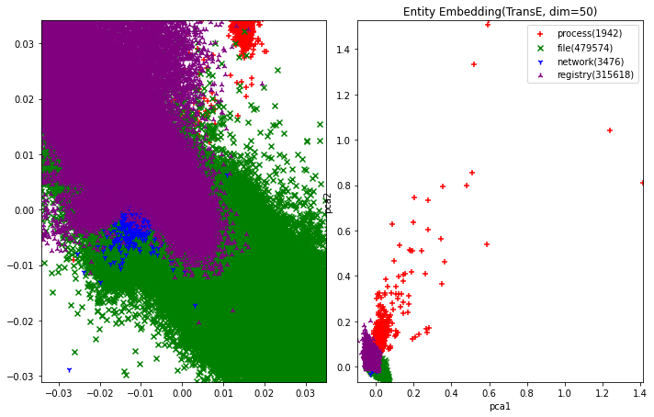
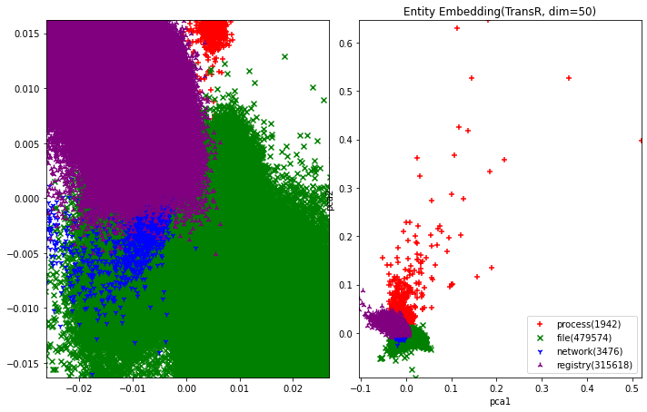
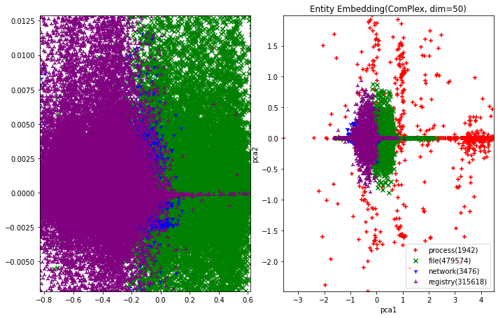
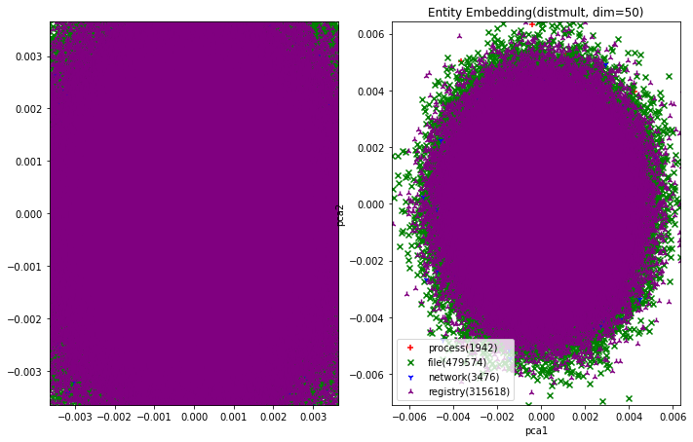
Embedding Visualization

Slide 67
Matcher
DL-based Method
Triplet
Sementic
Inference
Detection
Model
Training
The key idea of this module is to
Provenance Graph Building
Triplets
Embeddings
FFNN
Windows
Audit Logs
Rule-based Method
Triplets / Custom Field Map / Valid Rules
Provenance Graph
registry:
attr:
- OOO: src_ooo - XXX: dst_xxx
relation:
network:
…
Valid Rule
Filter
Multi-process Matcher
selection:
- ZZZ: ^A.*B$
filter:
- XXX: ^(?=.*H)(?=.*I).*$
Triplets
selection:
- ZZZ: ^A.*B$
filter:
- XXX: ^(?=.*H)(?=.*I).*$
Rule
Converter
selection:
- ZZZ: ^A.*B$
filter:
- XXX: ^(?=.*H)(?=.*I).*$
selection:
- ZZZ: ^A.*B$
filter:
- XXX: ^(?=.*H)(?=.*I).*$
Benign
Sigma Rule
(Human readable)
Rule Database
(Machine readable)
T1111
T2222
T1070.005
TTP
Graph
Reconstruction
TTP graph
(T1070.005)
Detected TTP Triplets
Notes:
DL Anomaly Detector
Rule Matching Engine 裡面的小模組才是重點，要畫出來

Slide 68
Evaluation of Sigma Rules
Synthesized 資料集中總事件數量：17,346,525
其中是 TTP 的事件數量：18,334
其中是 Benign 的事件數量：17,328,191
Sigma Rule | # of Detected Events | # of Detected TTPs | # of Detected Rules | F1-score | Precision Recall
All rules(1430) | 53868 | 119 | 200 | 0.0147 | 0.0098 0.0289
Stable(43)
Experimental(739)
Test(648)
Notes:
Synthesized 資料集中總事件數量：17,346,525
含 TTP 的事件數量：18,334
Benign 的事件數量：17,328,191
Precision: 偵測是 TTP 的事件數量中真的是 TTP 的比例
Recall: 真的是 TTP的事件數量中被偵測是 TTP 的比例

Slide 69
Interesting Questions for Sigma Rule
How’s the completeness(完整性) of Sigma rules?
目前共有 1430 Sigma windows rules，其中涵蓋的 TTP 有 250 個
1430 中只有 43 個是 “stable” rules，涵蓋 38 個 TTP
因為現在可用在 windows 的 MITRE techniques 有 421 個，Sigma 僅能偵測 38 個，並不算完整。
How’s the effectiveness(有效性) of Sigma rules?
all rules 偵測結果的 f1-score
stable / expenrimental / test rule 偵測結果的 f1-score
觀察偵測出來的Case
Note.
There are 5 rule status defined by the official document.
stable / test / experimental / deprecated / unsupported
- experimental: 739 - test: 648 - stable: 43
Notes:
Sigma Rule 有分成 5 種狀態：stable / test / experimental / deprecated / unsupported，目前我們搜集來用的 1430 個 rules 都是前三種狀態。分佈是：
experimental: 739 個
test: 648 個
stable: 43 個

Slide 70
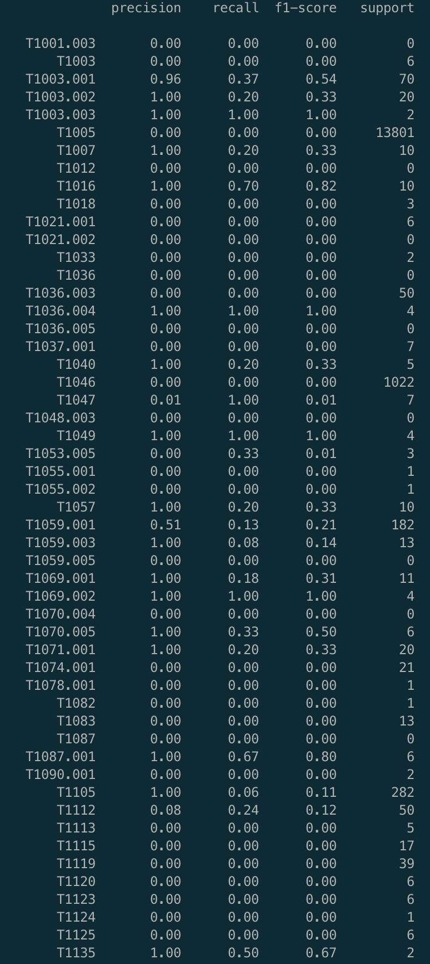
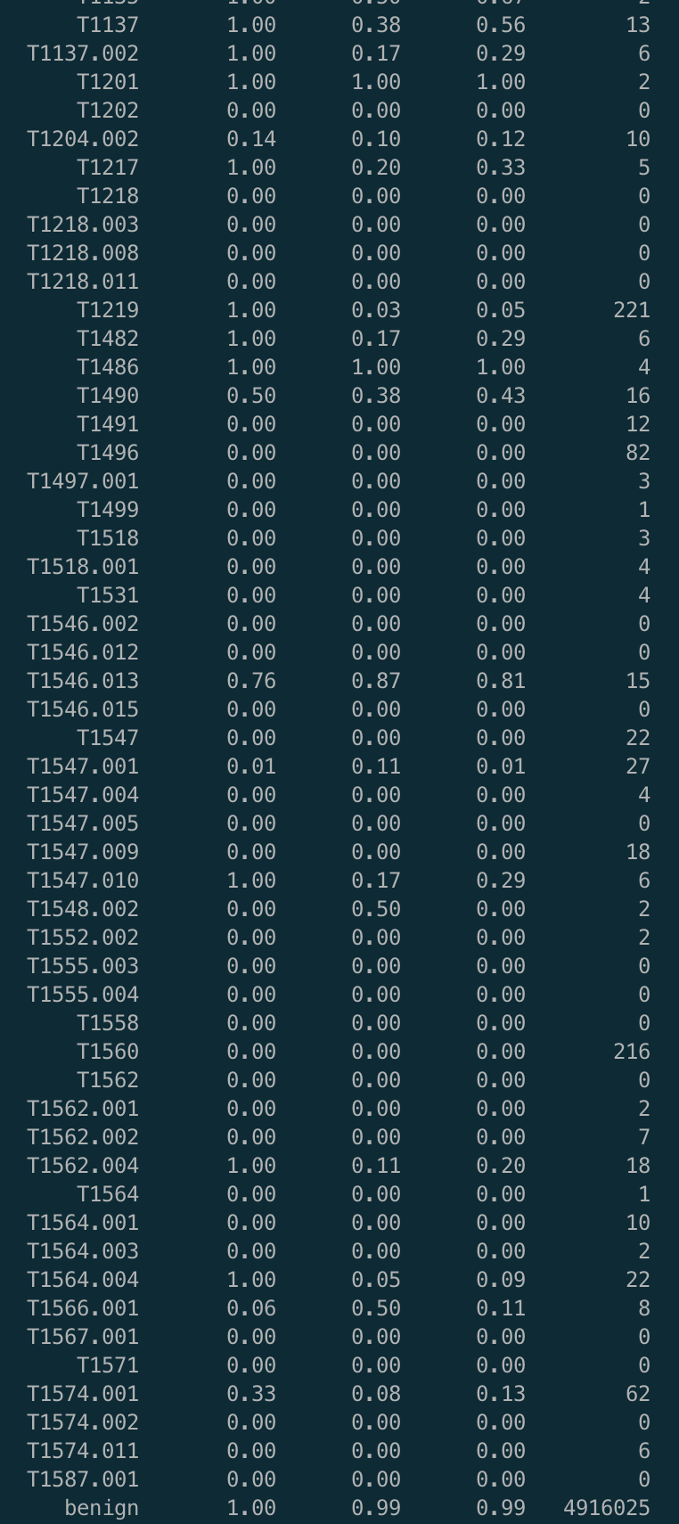
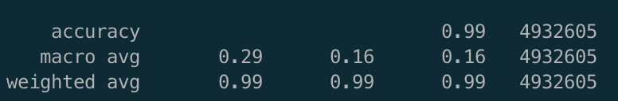
Rule-based

Slide 71
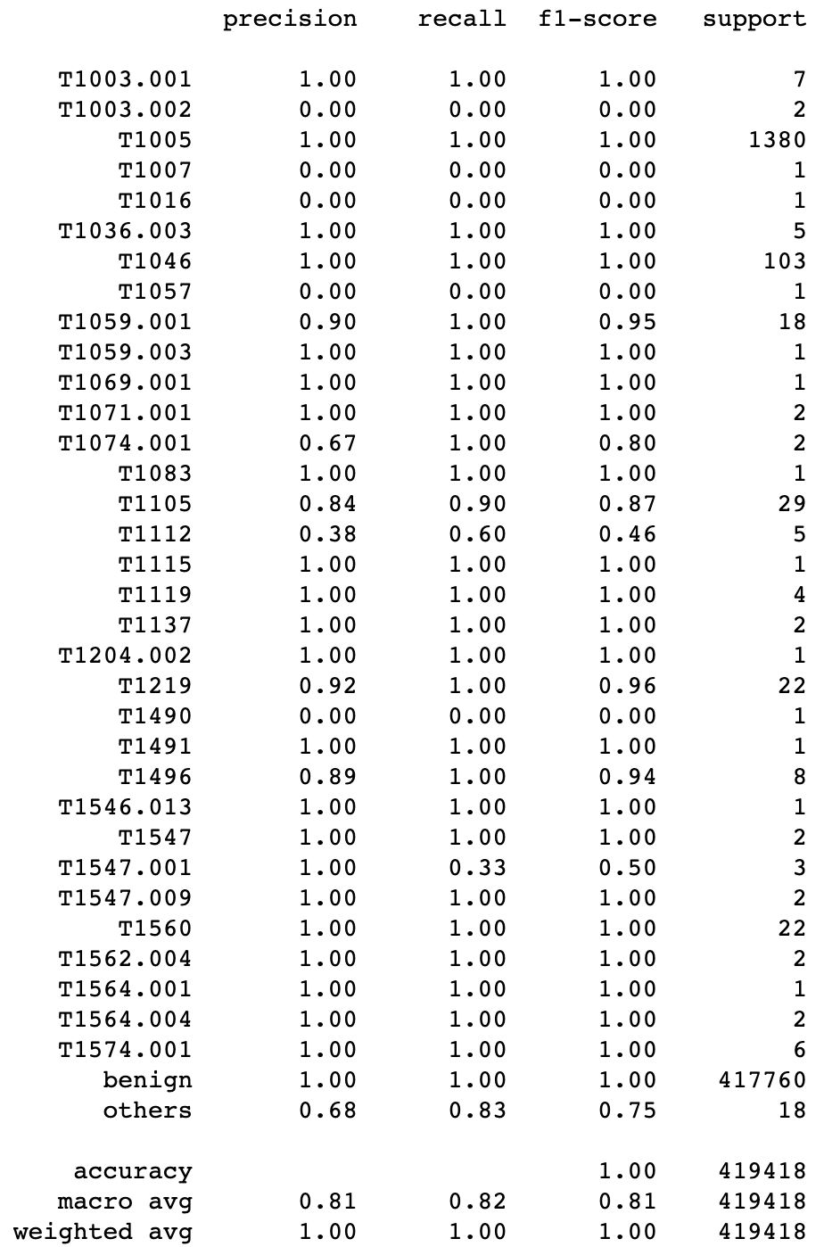
DL-based

Slide 72
Insight?
DL-based Method
Triplet
Sementic
Inference
Detection
Model
Training
Provenance Graph Building
Triplets
Embeddings
FFNN
Windows
Audit Logs
The advantage and disadvantage?
Observation?
Triplets / Custom Field Map / Valid Rules
Rule-based Method
Provenance Graph
registry:
attr:
- OOO: src_ooo - XXX: dst_xxx
relation:
network:
…
Valid Rule
Filter
Multi-process Matcher
selection:
- ZZZ: ^A.*B$
filter:
- XXX: ^(?=.*H)(?=.*I).*$
Triplets
selection:
- ZZZ: ^A.*B$
filter:
- XXX: ^(?=.*H)(?=.*I).*$
Rule
Converter
selection:
- ZZZ: ^A.*B$
filter:
- XXX: ^(?=.*H)(?=.*I).*$
selection:
- ZZZ: ^A.*B$
filter:
- XXX: ^(?=.*H)(?=.*I).*$
Benign
Sigma Rule
(Human readable)
Rule Database
(Machine readable)
T1111
T2222
T1070.005
TTP
Graph
Reconstruction
TTP graph
(T1070.005)
Detected TTP Triplets
Notes:
DL Anomaly Detector
Rule Matching Engine 裡面的小模組才是重點，要畫出來

Slide 74
Related Works in Rule(Heuristics-based) provenance analysis
 | Detection Target | Target Labels | Rule Source | Datasets | 備註
Holmes 2019 | Subgraph | APT Stage | Customized | DARPA | high-level scenario graph(HSG) /Severity Score
Rapsheet 2020 | Subgraph | MITRE Technique | Symantec EDR tool | EDR | Tactical Provenance Graph (TPG)
Krystal 2022 | Triplet | MITRE Technique | Sigma | DARPA | transforms Sigma into SPARQL query expressions.
SteinerLog 2022 | Triplet | MITRE Technique | Simga Splunk to MITRE Att&ck Translation Mitre CAR Repository | OpTC(operational teansparent Cyber) | transforms Sigma into Elasticsearch query
Note 1. The existing works can be categorized by the granularity of detection target: Node / Event(Triplet) / Path / Subgraph.

Slide 75
Related Works in ML-based provenance analysis
 | Detection Target | Target Labels | Embedding | Datasets | ML method | Attack Label 怎標？ supervised or un? | 備註
Atlas 2021 | Path | Attack / Benign | word representation | Synthesized APT |  |  | Node-> Triplet->Path
Prographer >2022 | Subgraph | Attack / Benign | graph2vec+ doc2vec | Stream Spot, DARPA TC(C/C/T), ATLAS, Production EDR |  |  | “Snapshot”
ShadeWatcher 2022 | Path | Attack / Benign | TransR+ GNN | DARPA, Synthesized |  |  | “Interaction”
Unicorn 2020 | Subgraph | Attack / Benign | Graph Sketching | Stream Spot, DARPA TC(C/C/T), Synthesized
Note 1. The existing works can be categorized by the granularity of detection target: Node / Event(Triplet) / Path / Subgraph.
Note 2. Embedding maps each target to a low-dimensional vector that preserves its key information. Take node as an example, the embedding should preserve the node’s neighborhood information, the node’s structural role. That’s why I take the embedding column into account.

Slide 76
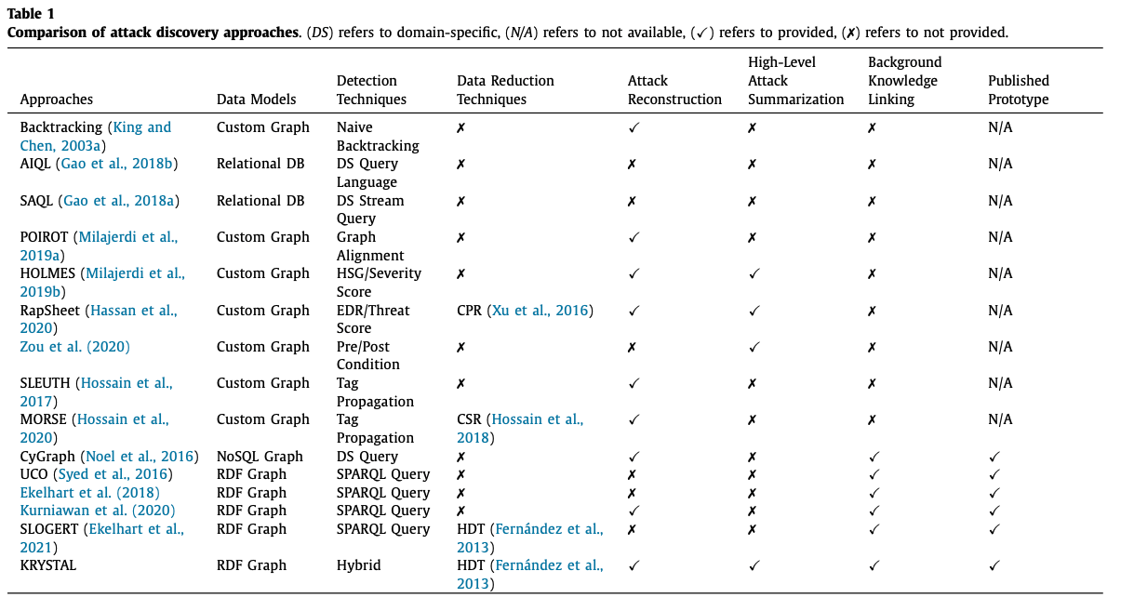
Notes:
2022 KRYSTAL: Knowledge graph-based framework for tactical attack discovery in audit data

Slide 77
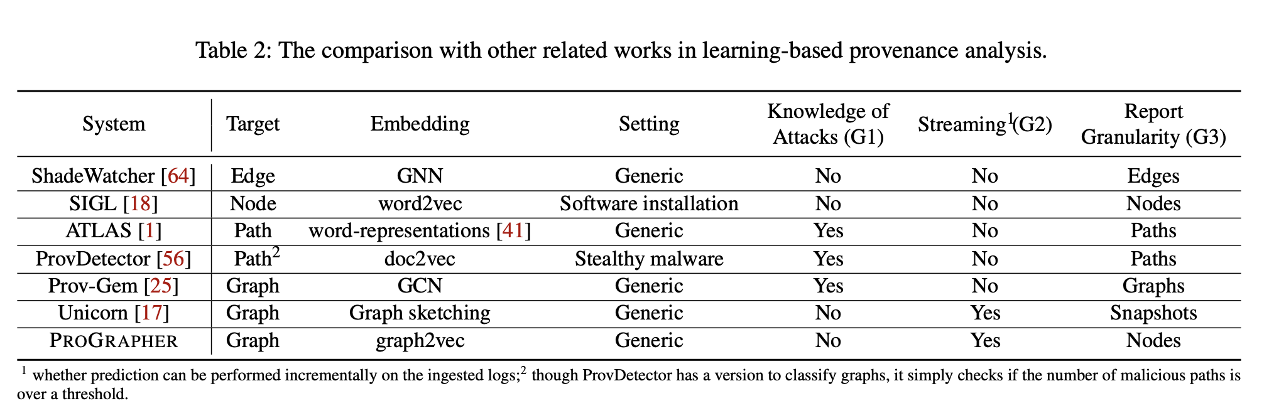
Notes:
PROGRAPHER- An Anomaly Detection System based on Provenance Graph Embedding

Slide 78
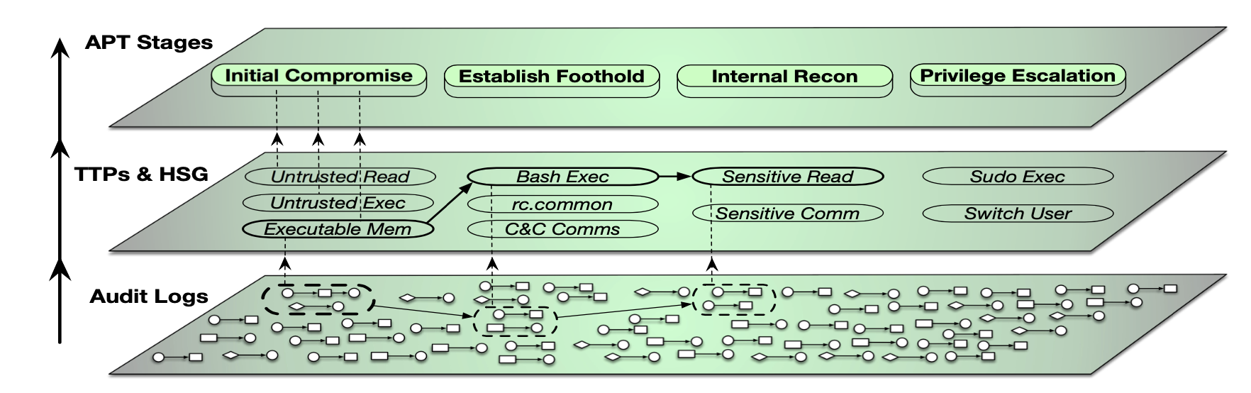
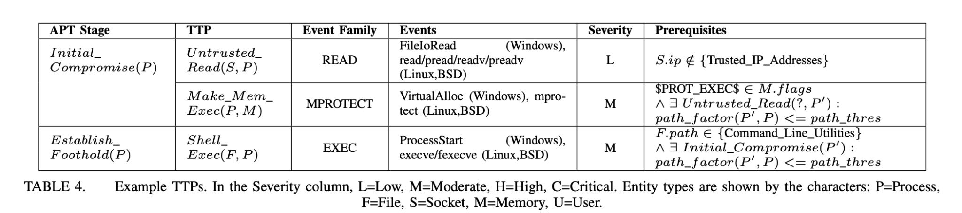
Holmes

Slide 79
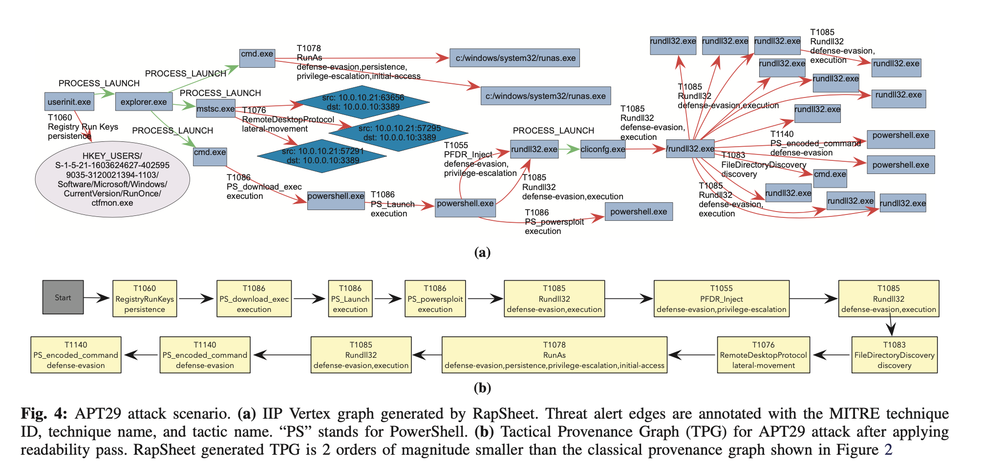
Rapsheet

Slide 80
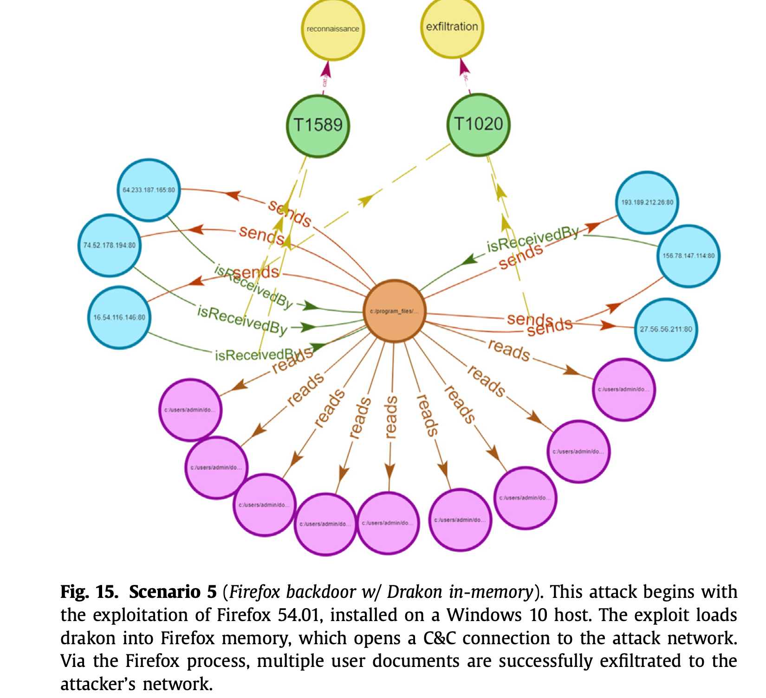
KRYSTAL

Slide 81
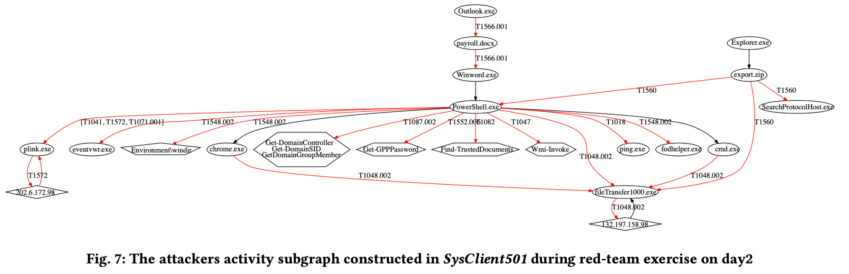
SteinerLog

